Slide 1
Week11a
WARMUP
What does this print?
PRINT(0.1 + 0.2);
PRINT(SQRT(2.0) * SQRT(2.0));
the Fibonacci sequence
recursion
dynamic programming
🦜🦜🦜🦜🦜🦜🦜🦜🦜🦜🦜
🍉
WARMUP
What is F₇?
F₀ = 0
F₁ = 1
F_{k} = F_{k - 1} + F_{k - 2}

Slide 2
what are these?
🍉

Slide 3

the

Slide 4
👼

Slide 5
the Fibonacci sequence

Slide 6


Slide 7
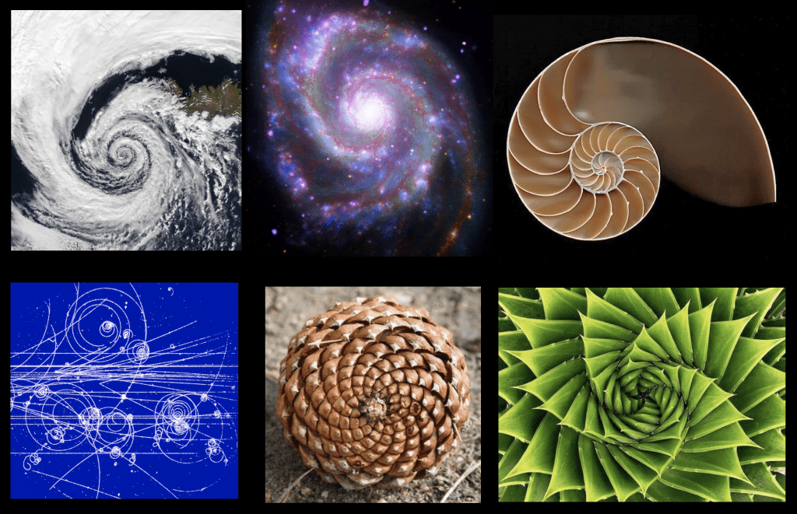

Slide 8
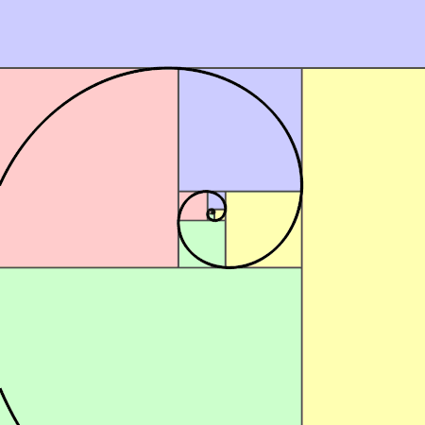

Slide 9
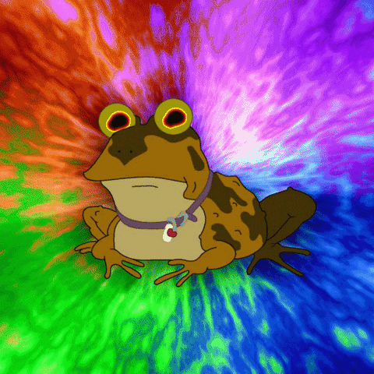

Slide 10
// F_0 = 0
// F_1 = 1
// F_2 = F_1 + F_0 = 1 + 0 = 1
// F_3 = F_2 + F_1 = 1 + 1 = 2
// F_4 = F_3 + F_2 = 2 + 1 = 3
// F_5 = F_4 + F_3 = 3 + 2 = 5
// F_6 = F_5 + F_4 = 5 + 3 = 8
// F_7 = F_6 + F_5 = 8 + 5 = 13
// ...

Slide 11
recursion

Slide 12
review: recursion basics

Slide 13
recursion
a recursive function is a function that calls itself
each call must make progress towards a base case (when the function finally returns without calling itself)
✨ when in doubt, try something like zero for your base case
class Main {
static int digitSum(int n) {
if (n == 0) {
return 0;
}
return digitSum(n / 10) + (n % 10);
}
public static void main(String[] arguments) {
PRINT(digitSum(256)); // 13
}
}

Slide 14
static int digitSum(int n) {
if (n == 0) {
return 0;
}
return digitSum(n / 10) + (n % 10);
}
return 0;
return digitSum(0) + 2;
return digitSum(2) + 5;
return digitSum(25) + 6;
int a = digitSum(256);

Slide 15
static int digitSum(int n) {
if (n == 0) {
return 0;
}
return digitSum(n / 10) + (n % 10);
}
return 0;
return digitSum(0) + 2;
return digitSum(2) + 5;
return digitSum(25) + 6;
int a = digitSum(256);

Slide 16
static int digitSum(int n) {
if (n == 0) {
return 0;
}
return digitSum(n / 10) + (n % 10);
}
return 0 + 2;
return digitSum(2) + 5;
return digitSum(25) + 6;
int a = digitSum(256);

Slide 17
static int digitSum(int n) {
if (n == 0) {
return 0;
}
return digitSum(n / 10) + (n % 10);
}
return 2;
return digitSum(2) + 5;
return digitSum(25) + 6;
int a = digitSum(256);

Slide 18
static int digitSum(int n) {
if (n == 0) {
return 0;
}
return digitSum(n / 10) + (n % 10);
}
return 2;
return digitSum(2) + 5;
return digitSum(25) + 6;
int a = digitSum(256);

Slide 19
static int digitSum(int n) {
if (n == 0) {
return 0;
}
return digitSum(n / 10) + (n % 10);
}
return 2 + 5;
return digitSum(25) + 6;
int a = digitSum(256);

Slide 20
static int digitSum(int n) {
if (n == 0) {
return 0;
}
return digitSum(n / 10) + (n % 10);
}
return 7;
return digitSum(25) + 6;
int a = digitSum(256);

Slide 21
static int digitSum(int n) {
if (n == 0) {
return 0;
}
return digitSum(n / 10) + (n % 10);
}
return 7;
return digitSum(25) + 6;
int a = digitSum(256);

Slide 22
static int digitSum(int n) {
if (n == 0) {
return 0;
}
return digitSum(n / 10) + (n % 10);
}
return 7 + 6;
int a = digitSum(256);

Slide 23
static int digitSum(int n) {
if (n == 0) {
return 0;
}
return digitSum(n / 10) + (n % 10);
}
return 13;
int a = digitSum(256);

Slide 24
static int digitSum(int n) {
if (n == 0) {
return 0;
}
return digitSum(n / 10) + (n % 10);
}
return 13;
int a = digitSum(256);

Slide 25
static int digitSum(int n) {
if (n == 0) {
return 0;
}
return digitSum(n / 10) + (n % 10);
}
int a = 13;

Slide 26
fin.

Slide 27
⚠️ recursion hazard 1 repeated computation

Slide 28
🐌 example: slow very slow fibonnaci (couldn't we just use a for loop...?)
// F_0 = 0
// F_1 = 1
// F_2 = F_1 + F_0 = 1 + 0 = 1
// F_3 = F_2 + F_1 = 1 + 1 = 2
// F_4 = F_3 + F_2 = 2 + 1 = 3
// F_5 = F_4 + F_3 = 3 + 2 = 5
// ...
static long fib(long k) {
if (k == 0) { return 0; }
if (k == 1) { return 1; }
return fib(k - 1) + fib(k - 2);
}

Slide 29
fib(4)

Slide 30
(fib(3) + fib(2))

Slide 31
((fib(2) + fib(1)) + (fib(1) + fib(0)))

Slide 32
(((fib(1) + fib(0)) + fib(1)) + (fib(1) + fib(0)))

Slide 33
(((1 + 0) + 1) + (1 + 0))

Slide 34
((1 + 1) + 1)

Slide 35
(2 + 1)

Slide 36
3

Slide 37
fib(4)

Slide 38
fib(4)
fib(3)
fib(2)

Slide 39
fib(4)
fib(3)
fib(2)
fib(2)
fib(1)

Slide 40
fib(4)
fib(3)
fib(2)
fib(2)
fib(1)
fib(1)
fib(0)

Slide 41
fib(4)
fib(3)
fib(2)
fib(2)
fib(1)
1
0

Slide 42
fib(4)
fib(3)
fib(2)
1
fib(1)

Slide 43
fib(4)
fib(3)
fib(2)
1
1

Slide 44
fib(4)
2
fib(2)

Slide 45
fib(4)
2
fib(2)
fib(1)
fib(0)

Slide 46
fib(4)
2
fib(2)
1
0

Slide 47
fib(4)
2
1

Slide 48
3

Slide 49
🙂

Slide 50
☹️

Slide 51
3

Slide 52
fib(4)

Slide 53
fib(4)
fib(3)
fib(2)
fib(2)
fib(1)
fib(1)
fib(0)
😱 what about this picture does NOT spark joy?
fib(1)
fib(0)

Slide 54
fib(4)
fib(3)
fib(2)
fib(2)
fib(1)
fib(1)
fib(0)
fib(1)
fib(0)

Slide 55
we computed fib(2) from scratch two seperate times 😱 we are repeating computation! (what a waste 😞)

Slide 56
and for bigger n... there is (much) more repetition

Slide 57
F₆
F₄
F₅
F₂
F₃
F₃
F₄
F₀
F₁
F₁
F₂
F₁
F₂
F₂
F₃
F₀
F₁
F₀
F₁
F₀
F₁
F₁
F₂
F₀
F₁

Slide 58

F₆
F₄
F₅
F₂
F₃
F₃
F₄
F₀
F₁
F₁
F₂
F₁
F₂
F₂
F₃
F₀
F₁
F₀
F₁
F₀
F₁
F₁
F₂
F₀
F₁
🧠 who's that
big O runtime?

Slide 59
exponential 🙀

Slide 60
[fib(5), fib(36), fib(77) demo]

Slide 61
⚠️ recursion hazard 2 stack overflow

Slide 62
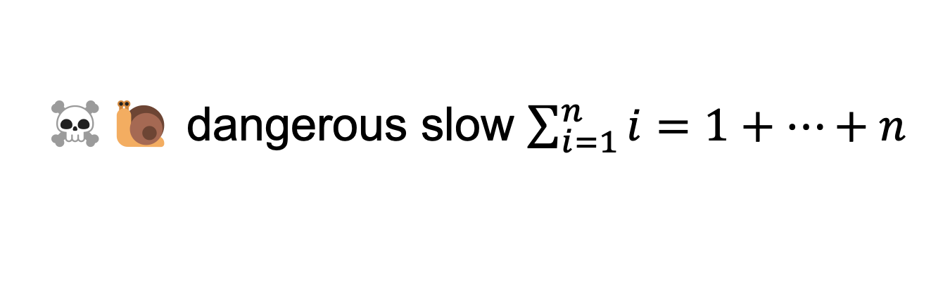
☠️🐌 dangerous slow $\sum_{i=1}^{n}{i}=1+…+n$
// 1 + ... + n
static int sum(int n) {
if (n == 0) return 0;
return n + sum(n - 1);
}

Slide 63
sum(100000)

Slide 64
sum(99999)
sum(100000)

Slide 65
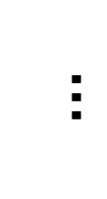
sum(0)
$$…$$
😱 what about this picture does NOT spark joy?
sum(99999)
sum(100000)

Slide 66
the height of the callstack is O(n) 😱 big n → stack overflow! 😞

Slide 67
[sum(100000) demo]

Slide 68
🧠 our depth-first binary (search) tree traversals were recursive... ...should we be worried about them overflowing the callstack?

Slide 69
no. (assuming your tree is ~balanced) callstack height for depth-first balanced binary tree traversal is log(n)
0
1
2
3
4 5
1 1 1 1 1 2 3
0 0 0 0 0 0 0 0 0 0 0
4
5
time

Slide 70
*additionally, some languages/compilers** have "tail-call optimization," which would prevent a stack overflow for sum(100000) **Java is not one of these languages (as our demo showed)

Slide 71
dynamic programming

Slide 72
dynamic programming is when you use the result of previous computation (this is a squishy definition)

Slide 73
F₆
F₄
F₅
F₂
F₃
F₃
F₄
F₀
F₁
F₁
F₂
F₁
F₂
F₂
F₃
F₀
F₁
F₀
F₁
F₀
F₁
F₁
F₂
F₀
F₁

Slide 74
F₆
F₅
F₄
F₄
F₃
F₃
F₂
F₂
F₁
F₁
F₀

Slide 75
F₆
F₅
F₄
F₄
F₃
F₃
F₂
F₂
F₁
F₁
F₀
🧠 who's that
big O runtime?

Slide 76
linear 🙂👍

Slide 77
memoization

Slide 78
memoization means storing the results of previous functions calls, so we don't have to repeat work when the function is called again

Slide 79
🙂 memoized fibonacci
static HashMap<Long, Long> table = new HashMap<>();
static long memoizedFib(long k) { // NOTE: long is an integer type
// that can store larger numbers than int
if (k == 0) { return 0; }
if (k == 1) { return 1; }
long Fkm1;
if (table.containsKey(k - 1)) {
Fkm1 = table.get(k - 1);
} else {
Fkm1 = memoizedFib(k - 1);
table.put(k - 1, Fkm1);
}
long Fkm2;
if (table.containsKey(k - 2)) {
Fkm2 = table.get(k - 2);
} else {
Fkm2 = memoizedFib(k - 2);
table.put(k - 2, Fkm2);
}
return Fkm1 + Fkm2;
}
🧠 what's the runtime of each call to memoizedFib(...)?
public static void main(...) {
int n = ...;
long a = memoizedFib(n);
long b = memoizedFib(n - 1);
long c = memoizedFib(n + 1);
}

Slide 80
int n = ...; long a = memoizedFib(n); // O(n) long b = memoizedFib(n - 1); // O(1) long c = memoizedFib(n + 1); // O(1)

Slide 81
👻 closed form fibonacci

Slide 82
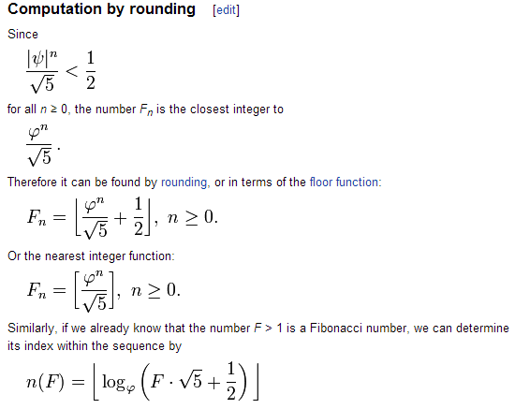

Slide 83
👻 approximate closed-form fibonnaci
// NOTE: Because of floating point error, this does not work for big n.
// (On my computer, returns wrong result for n > 70.)
static long closedFormFib(long n) {
final double goldenRatio = (1.0 + Math.sqrt(5.0)) / 2.0;
return Math.round(Math.pow(goldenRatio, n) / Math.sqrt(5.0));
}

Slide 84
exponentiation by squaring

Slide 85
note: there is actually a log(n) algorithm using matrices and "exponentiation by squaring" this algorithm does NOT have floating point problems (all numbers are integers)

Slide 86
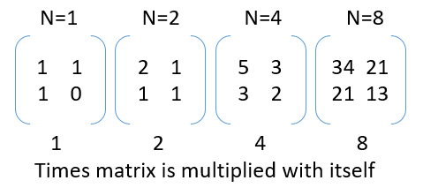

Slide 87
Week11b
🍉
WARMUP
Say n = 64
Your goal is to compute 3^n ("3 to the n-th power") using only the multiplication operator (*)
Give an O(n) algorithm
Give an O(log n) algorithm
Fibonacci wrapup
recursion example
🦜🦜🦜🦜🦜🦜🦜🦜🦜🦜🦜

Slide 88
recursive fibonacci wrapup

Slide 89
review: bad bad very bad recursive O(2^n) fibonacci

Slide 90
🐌 recursive O(2^n) fibonacci
static long fib(long k) {
if (k == 0) { return 0; }
if (k == 1) { return 1; }
return fib(k - 1) + fib(k - 2);
}

Slide 91
review: recursive memoized O(n) fibonacci

Slide 92
🙂 memoized recursive O(n) fibonacci
// NOTE: Could also have used an array, with, for example, value 0 meaning "not yet computed."
static HashMap<Integer, Long> table = new HashMap<>();
static long fib(int k) {
if (k == 0) { return 0; }
if (k == 1) { return 1; }
long Fkm1;
if (table.containsKey(k - 1)) {
Fkm1 = table.get(k - 1);
} else {
Fkm1 = fib(k - 1);
table.put(k - 1, Fkm1);
}
long Fkm2;
if (table.containsKey(k - 2)) {
Fkm2 = table.get(k - 2);
} else {
Fkm2 = fib(k - 2);
table.put(k - 2, Fkm2);
}
return Fkm1 + Fkm2;
}

Slide 93
can we get the best of both worlds? (easy to read, fast)

Slide 94
[add a helper function]

Slide 95
🙂 recursive O(n) fibonnaci
// NOTE: Could also have used an array, with value -1 meaning "not yet computed."
static HashMap<Integer, Long> table = new HashMap<>();
static long F(int k) {
long F_k;
if (table.containsKey(k)) {
F_k = table.get(k);
} else {
F_k = fib(k);
table.put(k, F_k);
}
}
static long fib(int n) {
if (n == 0) { return 0; }
if (n == 1) { return 1; }
return F(n – 1) + F(n – 2);
}

Slide 96
alternate fibonacci approaches

Slide 97
iterative O(n) fibonacci

Slide 98
🙂 iterative O(n) fibonnaci
(F₁, F₀) ← = (1, 0)
(F₂, F₁) ← (1 + 0, 1) = (1, 1)
(F₃, F₂) ← (1 + 1, 1) = (2, 1)
(F₄, F₃) ← (2 + 1, 2) = (3, 2)
(F₅, F₄) ← (3 + 2, 3) = (5, 3)
static long fib(int n) {
long F_i = 1;
long F_im1 = 0;
for (int i = 2; i <= n; ++i) {
// (F_i, F_im1) <- (F_i + F_im1, F_i)
long tmp = F_i;
F_i += F_im1;
F_im1 = tmp;
}
return F_i;
}
def fib(n):
F_i = 1
F_im1 = 0
for i in range(2, n + 1):
F_i, F_im1 = (F_i + F_im1), F_i
return F_im1

Slide 99
closed form fibonacci

Slide 101
👻 approximate closed-form fibonnaci
// NOTE: Because of floating point error, this does not work for big n.
// (On my computer, returns wrong result for n > 70.)
static long closedFormFib(long n) {
final double goldenRatio = (1.0 + Math.sqrt(5.0)) / 2.0;
return Math.round(Math.pow(goldenRatio, n) / Math.sqrt(5.0));
}

Slide 102
O(log n) matrix exponentiation by squaring (oh no) 😀

Slide 103
problem: calculate fib(64) observation: 64 = 2 * 2 * 2 * 2 * 2 * 2

Slide 104
[matrix multiplication review]

Slide 105
[update rule]

Slide 106
[handling n that aren't powers of 2]

Slide 107
recursion example subset sum

Slide 108
problem overview

Slide 109
given a finite set of numbers $\{a,b,c,…\}$, is there any subset that sums to target $T$?

Slide 110
no. --Mark

Slide 111
examples
is there any subset of { 1, 3, 5 } that sums to 4?
yes; { 1, 3 }
is there any subset of { 1, 3, 5 } that sums to 9?
yes; { 1, 3, 5 }
is there any subset of { 1, 3, 5 } that sums to 0?
yes; {}
is there any subset of { 1, 3, 5 } that sums to 7?
no

Slide 112
solution method

Slide 113
given a finite set of numbers $\{a,b,c,…\}$, is there any subset that sums to target $T$?

Slide 114
given a finite set of numbers $\{a,b,c,…\}$, is there any subset that sums to target $T$?

Slide 115
any
for each subset...
if it sums to target...
return true; 🙂
return false;

Slide 116
🧠 why is this maybe not so easy? "hard" means "hard for a computer to solve quickly"

Slide 117
what are the subsets of $\{ 1, 2, 3, 4, 5, 6, 7, 8, 9 \}$?

Slide 118
∅ | {1} | {2} | {3} | {4} | {5} | {6} | {7} | {8} | {9} | {1, 2} | {1, 3} | {1, 4} | {1, 5} | {1, 6} | {1, 7} | {1, 8} | {1, 9} | {2, 3} | {2, 4} | {2, 5} | {2, 6} | {2, 7} | {2, 8} | {2, 9} | {3, 4} | {3, 5} | {3, 6} | {3, 7} | {3, 8} | {3, 9} | {4, 5} | {4, 6} | {4, 7} | {4, 8} | {4, 9} | {5, 6} | {5, 7} | {5, 8} | {5, 9} | {6, 7} | {6, 8} | {6, 9} | {7, 8} | {7, 9} | {8, 9} | {1, 2, 3} | {1, 2, 4} | {1, 2, 5} | {1, 2, 6} | {1, 2, 7} | {1, 2, 8} | {1, 2, 9} | {1, 3, 4} | {1, 3, 5} | {1, 3, 6} | {1, 3, 7} | {1, 3, 8} | {1, 3, 9} | {1, 4, 5} | {1, 4, 6} | {1, 4, 7} | {1, 4, 8} | {1, 4, 9} | {1, 5, 6} | {1, 5, 7} | {1, 5, 8} | {1, 5, 9} | {1, 6, 7} | {1, 6, 8} | {1, 6, 9} | {1, 7, 8} | {1, 7, 9} | {1, 8, 9} | {2, 3, 4} | {2, 3, 5} | {2, 3, 6} | {2, 3, 7} | {2, 3, 8} | {2, 3, 9} | {2, 4, 5} | {2, 4, 6} | {2, 4, 7} | {2, 4, 8} | {2, 4, 9} | {2, 5, 6} | {2, 5, 7} | {2, 5, 8} | {2, 5, 9} | {2, 6, 7} | {2, 6, 8} | {2, 6, 9} | {2, 7, 8} | {2, 7, 9} | {2, 8, 9} | {3, 4, 5} | {3, 4, 6} | {3, 4, 7} | {3, 4, 8} | {3, 4, 9} | {3, 5, 6} | {3, 5, 7} | {3, 5, 8} | {3, 5, 9} | {3, 6, 7} | {3, 6, 8} | {3, 6, 9} | {3, 7, 8} | {3, 7, 9} | {3, 8, 9} | {4, 5, 6} | {4, 5, 7} | {4, 5, 8} | {4, 5, 9} | {4, 6, 7} | {4, 6, 8} | {4, 6, 9} | {4, 7, 8} | {4, 7, 9} | {4, 8, 9} | {5, 6, 7} | {5, 6, 8} | {5, 6, 9} | {5, 7, 8} | {5, 7, 9} | {5, 8, 9} | {6, 7, 8} | {6, 7, 9} | {6, 8, 9} | {7, 8, 9} | {1, 2, 3, 4} | {1, 2, 3, 5} | {1, 2, 3, 6} | {1, 2, 3, 7} | {1, 2, 3, 8} | {1, 2, 3, 9} | {1, 2, 4, 5} | {1, 2, 4, 6} | {1, 2, 4, 7} | {1, 2, 4, 8} | {1, 2, 4, 9} | {1, 2, 5, 6} | {1, 2, 5, 7} | {1, 2, 5, 8} | {1, 2, 5, 9} | {1, 2, 6, 7} | {1, 2, 6, 8} | {1, 2, 6, 9} | {1, 2, 7, 8} | {1, 2, 7, 9} | {1, 2, 8, 9} | {1, 3, 4, 5} | {1, 3, 4, 6} | {1, 3, 4, 7} | {1, 3, 4, 8} | {1, 3, 4, 9} | {1, 3, 5, 6} | {1, 3, 5, 7} | {1, 3, 5, 8} | {1, 3, 5, 9} | {1, 3, 6, 7} | {1, 3, 6, 8} | {1, 3, 6, 9} | {1, 3, 7, 8} | {1, 3, 7, 9} | {1, 3, 8, 9} | {1, 4, 5, 6} | {1, 4, 5, 7} | {1, 4, 5, 8} | {1, 4, 5, 9} | {1, 4, 6, 7} | {1, 4, 6, 8} | {1, 4, 6, 9} | {1, 4, 7, 8} | {1, 4, 7, 9} | {1, 4, 8, 9} | {1, 5, 6, 7} | {1, 5, 6, 8} | {1, 5, 6, 9} | {1, 5, 7, 8} | {1, 5, 7, 9} | {1, 5, 8, 9} | {1, 6, 7, 8} | {1, 6, 7, 9} | {1, 6, 8, 9} | {1, 7, 8, 9} | {2, 3, 4, 5} | {2, 3, 4, 6} | {2, 3, 4, 7} | {2, 3, 4, 8} | {2, 3, 4, 9} | {2, 3, 5, 6} | {2, 3, 5, 7} | {2, 3, 5, 8} | {2, 3, 5, 9} | {2, 3, 6, 7} | {2, 3, 6, 8} | {2, 3, 6, 9} | {2, 3, 7, 8} | {2, 3, 7, 9} | {2, 3, 8, 9} | {2, 4, 5, 6} | {2, 4, 5, 7} | {2, 4, 5, 8} | {2, 4, 5, 9} | {2, 4, 6, 7} | {2, 4, 6, 8} | {2, 4, 6, 9} | {2, 4, 7, 8} | {2, 4, 7, 9} | {2, 4, 8, 9} | {2, 5, 6, 7} | {2, 5, 6, 8} | {2, 5, 6, 9} | {2, 5, 7, 8} | {2, 5, 7, 9} | {2, 5, 8, 9} | {2, 6, 7, 8} | {2, 6, 7, 9} | {2, 6, 8, 9} | {2, 7, 8, 9} | {3, 4, 5, 6} | {3, 4, 5, 7} | {3, 4, 5, 8} | {3, 4, 5, 9} | {3, 4, 6, 7} | {3, 4, 6, 8} | {3, 4, 6, 9} | {3, 4, 7, 8} | {3, 4, 7, 9} | {3, 4, 8, 9} | {3, 5, 6, 7} | {3, 5, 6, 8} | {3, 5, 6, 9} | {3, 5, 7, 8} | {3, 5, 7, 9} | {3, 5, 8, 9} | {3, 6, 7, 8} | {3, 6, 7, 9} | {3, 6, 8, 9} | {3, 7, 8, 9} | {4, 5, 6, 7} | {4, 5, 6, 8} | {4, 5, 6, 9} | {4, 5, 7, 8} | {4, 5, 7, 9} | {4, 5, 8, 9} | {4, 6, 7, 8} | {4, 6, 7, 9} | {4, 6, 8, 9} | {4, 7, 8, 9} | {5, 6, 7, 8} | {5, 6, 7, 9} | {5, 6, 8, 9} | {5, 7, 8, 9} | {6, 7, 8, 9} | {1, 2, 3, 4, 5} | {1, 2, 3, 4, 6} | {1, 2, 3, 4, 7} | {1, 2, 3, 4, 8} | {1, 2, 3, 4, 9} | {1, 2, 3, 5, 6} | {1, 2, 3, 5, 7} | {1, 2, 3, 5, 8} | {1, 2, 3, 5, 9} | {1, 2, 3, 6, 7} | {1, 2, 3, 6, 8} | {1, 2, 3, 6, 9} | {1, 2, 3, 7, 8} | {1, 2, 3, 7, 9} | {1, 2, 3, 8, 9} | {1, 2, 4, 5, 6} | {1, 2, 4, 5, 7} | {1, 2, 4, 5, 8} | {1, 2, 4, 5, 9} | {1, 2, 4, 6, 7} | {1, 2, 4, 6, 8} | {1, 2, 4, 6, 9} | {1, 2, 4, 7, 8} | {1, 2, 4, 7, 9} | {1, 2, 4, 8, 9} | {1, 2, 5, 6, 7} | {1, 2, 5, 6, 8} | {1, 2, 5, 6, 9} | {1, 2, 5, 7, 8} | {1, 2, 5, 7, 9} | {1, 2, 5, 8, 9} | {1, 2, 6, 7, 8} | {1, 2, 6, 7, 9} | {1, 2, 6, 8, 9} | {1, 2, 7, 8, 9} | {1, 3, 4, 5, 6} | {1, 3, 4, 5, 7} | {1, 3, 4, 5, 8} | {1, 3, 4, 5, 9} | {1, 3, 4, 6, 7} | {1, 3, 4, 6, 8} | {1, 3, 4, 6, 9} | {1, 3, 4, 7, 8} | {1, 3, 4, 7, 9} | {1, 3, 4, 8, 9} | {1, 3, 5, 6, 7} | {1, 3, 5, 6, 8} | {1, 3, 5, 6, 9} | {1, 3, 5, 7, 8} | {1, 3, 5, 7, 9} | {1, 3, 5, 8, 9} | {1, 3, 6, 7, 8} | {1, 3, 6, 7, 9} | {1, 3, 6, 8, 9} | {1, 3, 7, 8, 9} | {1, 4, 5, 6, 7} | {1, 4, 5, 6, 8} | {1, 4, 5, 6, 9} | {1, 4, 5, 7, 8} | {1, 4, 5, 7, 9} | {1, 4, 5, 8, 9} | {1, 4, 6, 7, 8} | {1, 4, 6, 7, 9} | {1, 4, 6, 8, 9} | {1, 4, 7, 8, 9} | {1, 5, 6, 7, 8} | {1, 5, 6, 7, 9} | {1, 5, 6, 8, 9} | {1, 5, 7, 8, 9} | {1, 6, 7, 8, 9} | {2, 3, 4, 5, 6} | {2, 3, 4, 5, 7} | {2, 3, 4, 5, 8} | {2, 3, 4, 5, 9} | {2, 3, 4, 6, 7} | {2, 3, 4, 6, 8} | {2, 3, 4, 6, 9} | {2, 3, 4, 7, 8} | {2, 3, 4, 7, 9} | {2, 3, 4, 8, 9} | {2, 3, 5, 6, 7} | {2, 3, 5, 6, 8} | {2, 3, 5, 6, 9} | {2, 3, 5, 7, 8} | {2, 3, 5, 7, 9} | {2, 3, 5, 8, 9} | {2, 3, 6, 7, 8} | {2, 3, 6, 7, 9} | {2, 3, 6, 8, 9} | {2, 3, 7, 8, 9} | {2, 4, 5, 6, 7} | {2, 4, 5, 6, 8} | {2, 4, 5, 6, 9} | {2, 4, 5, 7, 8} | {2, 4, 5, 7, 9} | {2, 4, 5, 8, 9} | {2, 4, 6, 7, 8} | {2, 4, 6, 7, 9} | {2, 4, 6, 8, 9} | {2, 4, 7, 8, 9} | {2, 5, 6, 7, 8} | {2, 5, 6, 7, 9} | {2, 5, 6, 8, 9} | {2, 5, 7, 8, 9} | {2, 6, 7, 8, 9} | {3, 4, 5, 6, 7} | {3, 4, 5, 6, 8} | {3, 4, 5, 6, 9} | {3, 4, 5, 7, 8} | {3, 4, 5, 7, 9} | {3, 4, 5, 8, 9} | {3, 4, 6, 7, 8} | {3, 4, 6, 7, 9} | {3, 4, 6, 8, 9} | {3, 4, 7, 8, 9} | {3, 5, 6, 7, 8} | {3, 5, 6, 7, 9} | {3, 5, 6, 8, 9} | {3, 5, 7, 8, 9} | {3, 6, 7, 8, 9} | {4, 5, 6, 7, 8} | {4, 5, 6, 7, 9} | {4, 5, 6, 8, 9} | {4, 5, 7, 8, 9} | {4, 6, 7, 8, 9} | {5, 6, 7, 8, 9} | {1, 2, 3, 4, 5, 6} | {1, 2, 3, 4, 5, 7} | {1, 2, 3, 4, 5, 8} | {1, 2, 3, 4, 5, 9} | {1, 2, 3, 4, 6, 7} | {1, 2, 3, 4, 6, 8} | {1, 2, 3, 4, 6, 9} | {1, 2, 3, 4, 7, 8} | {1, 2, 3, 4, 7, 9} | {1, 2, 3, 4, 8, 9} | {1, 2, 3, 5, 6, 7} | {1, 2, 3, 5, 6, 8} | {1, 2, 3, 5, 6, 9} | {1, 2, 3, 5, 7, 8} | {1, 2, 3, 5, 7, 9} | {1, 2, 3, 5, 8, 9} | {1, 2, 3, 6, 7, 8} | {1, 2, 3, 6, 7, 9} | {1, 2, 3, 6, 8, 9} | {1, 2, 3, 7, 8, 9} | {1, 2, 4, 5, 6, 7} | {1, 2, 4, 5, 6, 8} | {1, 2, 4, 5, 6, 9} | {1, 2, 4, 5, 7, 8} | {1, 2, 4, 5, 7, 9} | {1, 2, 4, 5, 8, 9} | {1, 2, 4, 6, 7, 8} | {1, 2, 4, 6, 7, 9} | {1, 2, 4, 6, 8, 9} | {1, 2, 4, 7, 8, 9} | {1, 2, 5, 6, 7, 8} | {1, 2, 5, 6, 7, 9} | {1, 2, 5, 6, 8, 9} | {1, 2, 5, 7, 8, 9} | {1, 2, 6, 7, 8, 9} | {1, 3, 4, 5, 6, 7} | {1, 3, 4, 5, 6, 8} | {1, 3, 4, 5, 6, 9} | {1, 3, 4, 5, 7, 8} | {1, 3, 4, 5, 7, 9} | {1, 3, 4, 5, 8, 9} | {1, 3, 4, 6, 7, 8} | {1, 3, 4, 6, 7, 9} | {1, 3, 4, 6, 8, 9} | {1, 3, 4, 7, 8, 9} | {1, 3, 5, 6, 7, 8} | {1, 3, 5, 6, 7, 9} | {1, 3, 5, 6, 8, 9} | {1, 3, 5, 7, 8, 9} | {1, 3, 6, 7, 8, 9} | {1, 4, 5, 6, 7, 8} | {1, 4, 5, 6, 7, 9} | {1, 4, 5, 6, 8, 9} | {1, 4, 5, 7, 8, 9} | {1, 4, 6, 7, 8, 9} | {1, 5, 6, 7, 8, 9} | {2, 3, 4, 5, 6, 7} | {2, 3, 4, 5, 6, 8} | {2, 3, 4, 5, 6, 9} | {2, 3, 4, 5, 7, 8} | {2, 3, 4, 5, 7, 9} | {2, 3, 4, 5, 8, 9} | {2, 3, 4, 6, 7, 8} | {2, 3, 4, 6, 7, 9} | {2, 3, 4, 6, 8, 9} | {2, 3, 4, 7, 8, 9} | {2, 3, 5, 6, 7, 8} | {2, 3, 5, 6, 7, 9} | {2, 3, 5, 6, 8, 9} | {2, 3, 5, 7, 8, 9} | {2, 3, 6, 7, 8, 9} | {2, 4, 5, 6, 7, 8} | {2, 4, 5, 6, 7, 9} | {2, 4, 5, 6, 8, 9} | {2, 4, 5, 7, 8, 9} | {2, 4, 6, 7, 8, 9} | {2, 5, 6, 7, 8, 9} | {3, 4, 5, 6, 7, 8} | {3, 4, 5, 6, 7, 9} | {3, 4, 5, 6, 8, 9} | {3, 4, 5, 7, 8, 9} | {3, 4, 6, 7, 8, 9} | {3, 5, 6, 7, 8, 9} | {4, 5, 6, 7, 8, 9} | {1, 2, 3, 4, 5, 6, 7} | {1, 2, 3, 4, 5, 6, 8} | {1, 2, 3, 4, 5, 6, 9} | {1, 2, 3, 4, 5, 7, 8} | {1, 2, 3, 4, 5, 7, 9} | {1, 2, 3, 4, 5, 8, 9} | {1, 2, 3, 4, 6, 7, 8} | {1, 2, 3, 4, 6, 7, 9} | {1, 2, 3, 4, 6, 8, 9} | {1, 2, 3, 4, 7, 8, 9} | {1, 2, 3, 5, 6, 7, 8} | {1, 2, 3, 5, 6, 7, 9} | {1, 2, 3, 5, 6, 8, 9} | {1, 2, 3, 5, 7, 8, 9} | {1, 2, 3, 6, 7, 8, 9} | {1, 2, 4, 5, 6, 7, 8} | {1, 2, 4, 5, 6, 7, 9} | {1, 2, 4, 5, 6, 8, 9} | {1, 2, 4, 5, 7, 8, 9} | {1, 2, 4, 6, 7, 8, 9} | {1, 2, 5, 6, 7, 8, 9} | {1, 3, 4, 5, 6, 7, 8} | {1, 3, 4, 5, 6, 7, 9} | {1, 3, 4, 5, 6, 8, 9} | {1, 3, 4, 5, 7, 8, 9} | {1, 3, 4, 6, 7, 8, 9} | {1, 3, 5, 6, 7, 8, 9} | {1, 4, 5, 6, 7, 8, 9} | {2, 3, 4, 5, 6, 7, 8} | {2, 3, 4, 5, 6, 7, 9} | {2, 3, 4, 5, 6, 8, 9} | {2, 3, 4, 5, 7, 8, 9} | {2, 3, 4, 6, 7, 8, 9} | {2, 3, 5, 6, 7, 8, 9} | {2, 4, 5, 6, 7, 8, 9} | {3, 4, 5, 6, 7, 8, 9} | {1, 2, 3, 4, 5, 6, 7, 8} | {1, 2, 3, 4, 5, 6, 7, 9} | {1, 2, 3, 4, 5, 6, 8, 9} | {1, 2, 3, 4, 5, 7, 8, 9} | {1, 2, 3, 4, 6, 7, 8, 9} | {1, 2, 3, 5, 6, 7, 8, 9} | {1, 2, 4, 5, 6, 7, 8, 9} | {1, 3, 4, 5, 6, 7, 8, 9} | {2, 3, 4, 5, 6, 7, 8, 9} | {1, 2, 3, 4, 5, 6, 7, 8, 9}

Slide 119
there are $2^{9}$ of them

Slide 120
🧠 why?

Slide 121
each of the 9 elements is either included or not included (excluded) in the subset 9 include/exclude decisions => 2⁹

Slide 122

enumerate

Slide 123
what are the subsets of $\{3, 4, 5\}$?

Slide 124
what are the subsets of $\{3, 4, 5\}$?
all possible subsets
include 5?
$$\{\}$$
$$\{5\}$$
$$\{4\}$$
$$\{4,5\}$$
$$\{3\}$$
$$\{3,5\}$$
$$\{3,4\}$$
$$\{3,4,5\}$$
include 4?
$$\{\}$$
$$\{4\}$$
$$\{3\}$$
$$\{3,4\}$$
no
yes
no
yes
include 3?
$$\{\}$$
$$\{3\}$$
no
yes
$$\{\}$$

Slide 125
hint

Slide 126
Question: “can any subset of $\left\{a,b,c,…\right\}$ sum to $T$?” key insight Considering just $a$, we have two cases: 1) exclude $a$ in this case, Equivalent Question: “can any subset of $\{b,c,…\}$ sum to $T$?” 2) include $a$ in this case, Equivalent Question: “can any subset of $\{b,c,…\}$ sum to $T−a$?”

Slide 127
does any subset of {} sum to 0?
include 2nd
element?
$$\{\}$$
$$\{5\}$$
$$\{4\}$$
$$\{4,5\}$$
$$\{3\}$$
$$\{3,5\}$$
$$\{3,4\}$$
$$\{3,4,5\}$$
$$\{\}$$
$$\{4\}$$
$$\{3\}$$
$$\{3,4\}$$
include 1st
element?
$$\{\}$$
does any subset of $\left\{5\right\}$ sum to 5?
$$\{3\}$$
include 0th
element?
does any subset of $\left\{4,5\right\}$ sum to 5?
$$\{\}$$
does any subset of $\left\{3,4,5\right\}$ sum to 8?

Slide 128
okay cool good luck

Slide 129

WARMUP
what is (0.1 + 0.1 + 0.1) ?
imagine you wanted to make this thing →
what would you implement 1st? 2nd?
what would you implement LAST? TODAY
who's to say
Bubble Bobble (NES)

Slide 130
Week10a
✨No Laptop Monday! ✨
binary search
binary search trees
WARMUP
how long does it take to find (search for) something in...
- an array list?
- a linked list?
what if the list is sorted?

Slide 131
[record lecture]

Slide 132
review: sorted

Slide 133
sorted

Slide 134
sorted
a sequence is sorted if its elements are "in order"
by convention, this means ascending order (going up from left to right)
[1, 2, 5, 6, 9, 13] is sorted
[9, 5, 1, 2, 6, 13] is unsorted (NOT sored)

Slide 135
search

Slide 136
search
to search means to look for something (in some data structure)
a simple search problem is finding a given value in an array / list
// get index of the first element in array with this value // returns -1 if value not found int find(int[] array, int value) { ... }
// Option B class FindResult { boolean success; int index; } FindResult find(int[] array, int value) { ... }

Slide 137
linear search (of an array / array list)

Slide 138
linear search (brute force search)
linear search looks at each element one by one
linear search works whether or not the list is sorted
linear search is O(n) (linear time) 😐
// get index of the first element in array with this value // returns -1 if value not found int linearSearch(int[] array, int value) { for (int i = 0; i < array.length; ++i) { if (array[i] == value) { return i; } } return -1; }

Slide 139
example: linear search for 17 [13 2 55 7 17 100 77]

Slide 140
example: linear search for 17 [13 2 55 7 17 100 77]

Slide 141
example: linear search for 17 [13 2 55 7 17 100 77]

Slide 142
example: linear search for 17 [13 2 55 7 17 100 77]

Slide 143
example: linear search for 17 [13 2 55 7 17 100 77]

Slide 144
example: linear search for 17 [13 2 55 7 17 100 77]

Slide 145
example: linear search for 17 [13 2 55 7 17 100 77]

Slide 146
example: linear search for 17 [13 2 55 7 17 100 77]

Slide 147
example: linear search for 17 [13 2 55 7 17 100 77]

Slide 148
example: linear search for 17 [13 2 55 7 17 100 77]

Slide 149
example: linear search for 17 [13 2 55 7 17 100 77]

Slide 151
example: linear search for 17 [1 2 4 5 6 8 9 10 11 13 15 16 17 18 19]

Slide 152
example: linear search for 17 [1 2 4 5 6 8 9 10 11 13 15 16 17 18 19]

Slide 153
example: linear search for 17 [1 2 4 5 6 8 9 10 11 13 15 16 17 18 19]

Slide 154
example: linear search for 17 [1 2 4 5 6 8 9 10 11 13 15 16 17 18 19]

Slide 155
example: linear search for 17 [1 2 4 5 6 8 9 10 11 13 15 16 17 18 19]

Slide 156
example: linear search for 17 [1 2 4 5 6 8 9 10 11 13 15 16 17 18 19]

Slide 157
example: linear search for 17 [1 2 4 5 6 8 9 10 11 13 15 16 17 18 19]

Slide 158
example: linear search for 17 [1 2 4 5 6 8 9 10 11 13 15 16 17 18 19]

Slide 159
example: linear search for 17 [1 2 4 5 6 8 9 10 11 13 15 16 17 18 19]

Slide 160
example: linear search for 17 [1 2 4 5 6 8 9 10 11 13 15 16 17 18 19]

Slide 161
example: linear search for 17 [1 2 4 5 6 8 9 10 11 13 15 16 17 18 19]

Slide 162
example: linear search for 17 [1 2 4 5 6 8 9 10 11 13 15 16 17 18 19]

Slide 163
example: linear search for 17 [1 2 4 5 6 8 9 10 11 13 15 16 17 18 19]

Slide 164
example: linear search for 17 [1 2 4 5 6 8 9 10 11 13 15 16 17 18 19]

Slide 165
example: linear search for 17 [1 2 4 5 6 8 9 10 11 13 15 16 17 18 19]

Slide 166
example: linear search for 17 [1 2 4 5 6 8 9 10 11 13 15 16 17 18 19]

Slide 167
example: linear search for 17 [1 2 4 5 6 8 9 10 11 13 15 16 17 18 19]

Slide 168
example: linear search for 17 [1 2 4 5 6 8 9 10 11 13 15 16 17 18 19]

Slide 169
example: linear search for 17 [1 2 4 5 6 8 9 10 11 13 15 16 17 18 19]

Slide 170
example: linear search for 17 [1 2 4 5 6 8 9 10 11 13 15 16 17 18 19]

Slide 171
example: linear search for 17 [1 2 4 5 6 8 9 10 11 13 15 16 17 18 19]

Slide 172
example: linear search for 17 [1 2 4 5 6 8 9 10 11 13 15 16 17 18 19]

Slide 173
example: linear search for 17 [1 2 4 5 6 8 9 10 11 13 15 16 17 18 19]

Slide 174
example: linear search for 17 [1 2 4 5 6 8 9 10 11 13 15 16 17 18 19]

Slide 175
example: linear search for 17 [1 2 4 5 6 8 9 10 11 13 15 16 17 18 19]

Slide 176
example: linear search for 17 [1 2 4 5 6 8 9 10 11 13 15 16 17 18 19]

Slide 177
example: linear search for 17 [1 2 4 5 6 8 9 10 11 13 15 16 17 18 19]

Slide 178
if we know that an array is sorted... can we search it faster?

Slide 179
yes 🚀

Slide 180
unless it's a linked list 💀

Slide 181
binary search (of a array / array list)

Slide 182
binary search
binary search is an O(log n) algorithm for searching a sorted array 🙂
binary search works by "cutting the array in half" over and over
☠️ binary search only applies if the array is sorted

Slide 183
example: binary search for 17 [1 2 4 5 6 8 9 10 11 13 15 16 17 18 19]

Slide 184
example: binary search for 17 [1 2 4 5 6 8 9 10 11 13 15 16 17 18 19]
10 < 17

Slide 185
example: binary search for 17 [1 2 4 5 6 8 9 10 11 13 15 16 17 18 19]

Slide 186
example: binary search for 17 [1 2 4 5 6 8 9 10 11 13 15 16 17 18 19]
16 < 17

Slide 187
example: binary search for 17 [1 2 4 5 6 8 9 10 11 13 15 16 17 18 19]

Slide 188
example: binary search for 17 [1 2 4 5 6 8 9 10 11 13 15 16 17 18 19]
17 < 18

Slide 189
example: binary search for 17 [1 2 4 5 6 8 9 10 11 13 15 16 17 18 19]

Slide 190
example: binary search for 17 [1 2 4 5 6 8 9 10 11 13 15 16 17 18 19]
17 == 17

Slide 191
example: binary search for 17 [1 2 4 5 6 8 9 10 11 13 15 16 17 18 19]

Slide 192
☠️ implementating binary search is surprisingly tricky! make sure you test thoroughly!

Slide 193
✨ hint: binary search [1 2 4 5 6 8 9 10 11 13 15 16 17 18 19]
[^ 2 4 5 6 8 9 10 11 13 15 16 17 18 ^ ]
[| 2 4 5 6 8 9 10 11 13 15 16 17 18 | ]
[i = 0 4 5 6 8 9 10 11 13 15 16 17 18 j ]

Slide 194
review: binary tree

Slide 195
binary tree

Slide 196
binary tree
a binary tree is a tree in which each node has <= 2 children
10
5
16
2
13
18
1
4
11
15
17

Slide 197
🧠 can a linked list be seen as a binary tree?

Slide 198
technically, yes (assuming no cycles) all nodes have <= 2 children (tail has 0 children, all other nodes have 1 child)

Slide 199
ordered binary tree

Slide 200
(ordered) binary tree
each node has a left child and a right child (either or both children can be null)
10
5
16
node
13
18
11
15
17
node.leftChild
node.rightChild

Slide 201
(ordered) binary tree
each node has a left subtree and a right subtree (and left descendants and right descendants)

Slide 202
binary search tree

Slide 203
binary search tree

Slide 204
binary search tree
in a binary search tree (BST, sorted binary tree) every node follows: "a node's value is greater than the values of all nodes in its left subtree and less than the values of all nodes in its right subtree"
10
5
16
2
13
18
1
4
11
15
17

Slide 205
binary search tree
in a binary search tree (BST, sorted binary tree) every node follows: "a node's value is greater than the values of all nodes in its left subtree and less than the values of all nodes in its right subtree"
10
10 < 16
5
16
5 < 10
2 < 10
10 < 13
2
13
18
10 < 18
1
4
10 < 11
11
15
17
10 < 17
4 < 10
1 < 10
10 < 15

Slide 206
binary search tree
in a binary search tree (BST, sorted binary tree) every node follows: "a node's value is greater than the values of all nodes in its left subtree and less than the values of all nodes in its right subtree"
10
5
16
13 < 16
2
13
18
16 < 18
1
4
11 < 16
11
15
17
16 < 17
15 < 16

Slide 207
binary search tree
in a binary search tree (BST, sorted binary tree) every node follows: "a node's value is greater than the values of all nodes in its left subtree and less than the values of all nodes in its right subtree"
10
5
16
2
13
18
1
4
11
15
17

Slide 208
is it a BST?

Slide 209
2
4
1
3
6
Is It A Binary Search Tree?
4
9
3
5
in a binary search tree (sorted binary tree) every node follows: "a node's value is greater than the values of all nodes in its left subtree and less than the values of all nodes in its right subtree"
2
1
10
5
16
2
8
13
18
1
4
6
9
14
15
17
19

Slide 210
2
4
1
3
6
4
9
3
5
in a binary search tree (sorted binary tree) every node follows: "a node's value is greater than the values of all nodes in its left subtree and less than the values of all nodes in its right subtree"
2
1
10
5
16
2
8
13
18
1
4
6
9
14
15
17
19

Slide 211
binary search (of a binary search tree)

Slide 212
binary search
binary search "cuts a BST in half" over and over
binary search only works when the binary tree is sorted (is a binary search tree)
binary search is O(log n) if the tree is "balanced" 🙂
balanced means each node's children are similar in height (intuitive understanding of this is sufficient; will discuss more on Fri)
10
10
5
16
5
2
8
13
18
2
1
6
9
11
9
1
balanced
NOT balanced

Slide 213
example: binary search for 17 [1 2 4 5 6 8 9 10 11 13 15 16 17 18 19]
10
5
16
2
8
13
18
1
4
6
9
11
15
17
19

Slide 214
example: binary search for 17 [1 2 4 5 6 8 9 10 11 13 15 16 17 18 19]
10
10 < 17
5
16
2
8
13
18
1
4
6
9
11
15
17
19

Slide 215
example: binary search for 17 [1 2 4 5 6 8 9 10 11 13 15 16 17 18 19]
10
5
16
2
8
13
18
1
4
6
9
11
15
17
19

Slide 216
example: binary search for 17 [1 2 4 5 6 8 9 10 11 13 15 16 17 18 19]
10
5
16
16 < 17
2
8
13
18
1
4
6
9
11
15
17
19

Slide 217
example: binary search for 17 [1 2 4 5 6 8 9 10 11 13 15 16 17 18 19]
10
5
16
2
8
13
18
1
4
6
9
11
15
17
19

Slide 218
example: binary search for 17 [1 2 4 5 6 8 9 10 11 13 15 16 17 18 19]
10
5
16
2
8
13
18
17 < 18
1
4
6
9
11
15
17
19

Slide 219
example: binary search for 17 [1 2 4 5 6 8 9 10 11 13 15 16 17 18 19]
10
5
16
2
8
13
18
1
4
6
9
11
15
17
19

Slide 220
example: binary search for 17 [1 2 4 5 6 8 9 10 11 13 15 16 17 18 19]
10
5
16
2
8
13
18
1
4
6
9
11
15
17
19
17 == 17

Slide 221
example: binary search for 17 [1 2 4 5 6 8 9 10 11 13 15 16 17 18 19]
10
5
16
2
8
13
18
1
4
6
9
11
15
17
19

Slide 222
note: a binary search tree is NOT unique let's look at another BST for the same data!

Slide 223
example: binary search for 17 [1 2 4 5 6 8 9 10 11 13 15 16 17 18 19]
2
1
4
5
6
8
9
10
11
13
15
16
17
18
19

Slide 224
example: binary search for 17 [1 2 4 5 6 8 9 10 11 13 15 16 17 18 19]
2
1
4
5
6
8
9
10
11
13
15
16
17
18
19

Slide 225
example: binary search for 17 [1 2 4 5 6 8 9 10 11 13 15 16 17 18 19]
2
1
4
5
6
8
9
10
11
13
15
16
17
18
19

Slide 226
example: binary search for 17 [1 2 4 5 6 8 9 10 11 13 15 16 17 18 19]
2
1
4
5
6
8
9
10
11
13
15
16
17
18
19

Slide 227
example: binary search for 17 [1 2 4 5 6 8 9 10 11 13 15 16 17 18 19]
2
1
4
5
6
8
9
10
11
13
15
16
17
18
19

Slide 228
example: binary search for 17 [1 2 4 5 6 8 9 10 11 13 15 16 17 18 19]
2
1
4
5
6
8
9
10
11
13
15
16
17
18
19

Slide 229
example: binary search for 17 [1 2 4 5 6 8 9 10 11 13 15 16 17 18 19]
2
1
4
5
6
8
9
10
11
13
15
16
17
18
19

Slide 230
example: binary search for 17 [1 2 4 5 6 8 9 10 11 13 15 16 17 18 19]
2
1
4
5
6
8
9
10
11
13
15
16
17
18
19

Slide 231
example: binary search for 17 [1 2 4 5 6 8 9 10 11 13 15 16 17 18 19]
2
1
4
5
6
8
9
10
11
13
15
16
17
18
19

Slide 232
...

Slide 233
life lesson: it is important that your binary search tree is ✨balanced✨ (otherwise your "binary search" degrades into linear search of a linked list ☹️)

Slide 234
adding a new node to a binary search tree (the naive (simple but bad) method)

Slide 235
for a binary search tree, add starts out just like search

Slide 236
just keep going until you hit a null node put the new node there 🙂👍

Slide 237
example: adding 7
10
5
16
2
8
13
18
1
4
6
9
11
15
17
19

Slide 238
example: adding 7
10
5
16
2
8
13
18
1
4
6
9
11
15
17
19

Slide 239
example: adding 7
10
5
16
2
8
13
18
1
4
6
9
11
15
17
19

Slide 240
example: adding 7
10
5
16
2
8
13
18
1
4
6
9
11
15
17
19

Slide 241
example: adding 7
10
5
16
2
8
13
18
1
4
6
9
11
15
17
19

Slide 242
example: adding 7
10
5
16
2
8
13
18
1
4
6
9
11
15
17
19
null

Slide 243
example: adding 7
10
5
16
2
8
13
18
1
4
6
9
11
15
17
19
7

Slide 244
example: adding 7
10
5
16
2
8
13
18
1
4
6
9
11
15
17
19
7

Slide 245
is this approach to adding a new node good? hint: no.

Slide 246
self-balancing binary search trees note: hard to implement

Slide 247


Slide 248
uses of binary search trees

Slide 249
tree map (implement a map)
you can implement the map interface using a BST NOTE: this is NOT a hash map!—no hashing is involved!
class Node {
String key; // NOTE: BST is sorted by key
Integer value;
Node leftChild;
Node rightChild;
}
class TreeMap { Node root;
ValueType get(KeyType) { ... }
void put(ValueType, KeyType) { ... }
}
"Ditto"
132
"Arbok"
24
"Mew"
151

Slide 250
Week10b
✨Wednesday! ✨
WARMUP
what does "sink or swim" mean?
BST traversal order review
heaps, heapsort
ANNOUNCEMENTS
Jim out of town Wed-Fri (TA's will run lab)
Tacos Tacos Tacos tomorrow at 7 pm

Slide 251
review: binary tree depth-first traversal orders

Slide 252
binary tree depth-first traversal orders

Slide 253
depth-first traversal orders (of a binary tree)
pre-order = self, left, right
3, 1, 0, 2, 5, 4, 6
in-order = left, self, right
0, 1, 2, 3, 4, 5, 6
post-order = left, right, self
0, 2, 1, 4, 6, 5, 3
reverse pre-order = self, right, left
3, 5, 6, 4, 1, 2, 0
reverse in-order = right, self, left
6, 5, 4, 3, 2, 1, 0
reverse post-order = right, left, self
6, 4, 5, 2, 0, 1, 3
3
1
5
0
2
4
6

Slide 254
2 * 3
+ 4
who's that
traversal order?
+
in-order!
*
4
2
3

Slide 255
the most satisfying function in CS 136
void recurse(Node self) {
// NOTE: rearranging these 3 lines gives you all
// 3! ("three factorial") = 6 traversal orders
if (self.leftChild != null) { recurse(self.leftChild); }
System.out.print(self.value + " ");
if (self.rightChild != null) { recurse(self.rightChild); }
}

Slide 256
[Live-code traversal orders] (Feel free to follow along or race.)

Slide 257
heaps

Slide 258
always-complete max binary heap

Slide 259
always-complete max binary heap
in this class, when we say "heap" or "max heap", we mean an "always-complete max binary heap"
we might occasionally mention a "min heap", which means an "always-complete min binary heap"

Slide 260
always-complete max binary heap
in a complete binary tree, all levels (depths, rows) are "full of nodes", except for possibly the bottom level, in which all nodes are "as far to to the left as possible"
10
10
5
16
5
16
2
8
13
18
2
8
13
18
1
4
6
9
11
1
4
6
11
complete
(and balanced)
balanced but NOT complete

Slide 261
always-complete max binary heap
in a complete binary tree, all levels (depths) are "full of nodes", except for possibly the bottom level, in which all nodes are "as far to to the left as possible"
10
5
16
2
8
13
18
1
4
6
9
the "last node"
complete
(and balanced)

Slide 262
always-complete max binary heap
"always-complete" means that every function in the Heap interface (add(...) & remove()) "preserves the completeness of the heap"
the heap was complete before calling add...
...and the heap is still complete after add returns
the heap is always complete
always complete.

Slide 263
always-complete max binary heap
a binary heap is another special kind of binary tree
☠️ a binary heap is NOT, in general, a binary search tree

Slide 264
always-complete max binary heap
in a max binary heap, every node follows: "a node's value is greater than the value of its left child and the value of its right child"
27
15
5
7
13
4
2
6
3
11
12
1

Slide 265
always-complete max binary heap
in a max binary heap, every node follows: "a node's value is greater than the value of its left child and the value of its right child"
27
27 > 15
27 > 5
15
5
7
13
4
2
6
3
11
12
1

Slide 266
always-complete max binary heap
in a max binary heap, every node follows: "a node's value is greater than the value of its left child and the value of its right child"
27
15
5
7
13
4
2
6
3
11
12
1
7 > 6
7 > 3

Slide 267
always-complete max binary heap
in a max binary heap, every node follows: "a node's value is greater than the value of its left child and the value of its right child"
🧠 is the "max heap property" above equivalent to...
in a max binary heap, every node follows: "a node's value is greater than the values of all its descendants"
yes.
idea: apply definition recursively
node's value is greater than the values of its children... ...which are greater than the values of their children...
🧠 which node always has the max value of all nodes in the heap?
the root

Slide 268
always-complete max binary heap
in a max binary heap, every node follows: "a node's value is greater than the values of all its descendants"
27
15
5
15 > 7
7
15 > 13
13
4
2
6
3
11
12
1
15 > 6
15 > 3
15 > 11
15 > 12

Slide 269
heap interface add(...) & remove() 🐡 ⚓️ a heap is like a benthic trawl net (ish)

Slide 270
heap interface
// Add this value to the heap. void add(ValueType value) { ... }
// Remove the max value from the heap, and return it. ValueType remove() { ... }

Slide 271
add(...)

Slide 272
void add(ValueType value);
to add a new node with a given value to a max binary heap...
add the new node so that the heap is still complete (add into "the next empty slot")
while that node violates the max heap property...
swap it with its parent
the node "swims up" 🐡
"sifts up"
"heap up"?

Slide 273
example: adding 10
27
15
5
7
13
4
2
6
3
11
12
1

Slide 274
example: adding 10
27
15
5
7
13
4
2
6
3
11
12
1

Slide 275
example: adding 10
27
15
5
7
13
4
2
6
3
11
12
1
10

Slide 276
example: adding 10
27
15
5
7
13
4
2
6
3
11
12
1
10

Slide 277
example: adding 10
27
15
5
7
13
4
2
6
3
11
12
1
10

Slide 278
example: adding 10
27
15
5
7
13
10
2
6
3
11
12
1
4

Slide 279
example: adding 10
27
15
5
7
13
10
2
6
3
11
12
1
4

Slide 280
example: adding 10
27
15
5
7
13
10
2
6
3
11
12
1
4

Slide 281
example: adding 10
27
15
5
7
13
10
2
6
3
11
12
1
4

Slide 282
example: adding 10
27
15
10
7
13
5
2
6
3
11
12
1
4

Slide 283
example: adding 10
27
15
10
7
13
5
2
6
3
11
12
1
4

Slide 284
example: adding 10
27
15
10
7
13
5
2
6
3
11
12
1
4

Slide 285
example: adding 10
27
15
10
7
13
5
2
6
3
11
12
1
4

Slide 286
example: adding 10
27
15
10
7
13
5
2
6
3
11
12
1
4

Slide 287
remove()

Slide 288
ValueType remove();
to remove the node with max value (the root) from a max binary heap...
save the root's value in a temporary variable called result
replace the root with the last node (rightmost node in the bottom level) (the old root is now "garbage" and ready to be garbage collected 🚛)
while that node violates the max heap property...
swap it with its larger child
return result;
the node "sinks down" ⚓️
"sifts down"
"heap down"?

Slide 289
example: removing max node
27
15
5
7
13
4
2
6
3
11
0
1

Slide 290
example: removing max node
int result = root.value;
27
15
5
7
13
4
2
6
3
11
0
1

Slide 291
example: removing max node
27
15
5
7
13
4
2
6
3
11
0
1

Slide 292
example: removing max node
27
15
5
7
13
4
2
6
3
11
0
1

Slide 293
example: removing max node
1
15
5
7
13
4
2
6
3
11
0

Slide 294
example: removing max node
1
15
5
7
13
4
2
6
3
11
0

Slide 295
example: removing max node
1
15
5
7
13
4
2
6
3
11
0

Slide 296
example: removing max node
1
15
5
7
13
4
2
6
3
11
0

Slide 297
example: removing max node
15
1
5
7
13
4
2
6
3
11
0

Slide 298
example: removing max node
15
1
5
7
13
4
2
6
3
11
0

Slide 299
example: removing max node
15
1
5
7
13
4
2
6
3
11
0

Slide 300
example: removing max node
15
1
5
7
13
4
2
6
3
11
0

Slide 301
example: removing max node
15
1
5
7
13
4
2
6
3
11
0

Slide 302
example: removing max node
15
13
5
7
1
4
2
6
3
11
0

Slide 303
example: removing max node
15
13
5
7
1
4
2
6
3
11
0

Slide 304
example: removing max node
15
13
5
7
1
4
2
6
3
11
0

Slide 305
example: removing max node
15
13
5
7
1
4
2
6
3
11
0

Slide 306
example: removing max node
15
13
5
7
11
4
2
6
3
1
0

Slide 307
example: removing max node
15
13
5
7
11
4
2
6
3
1
0

Slide 308
example: removing max node
15
13
5
7
11
4
2
6
3
1
0

Slide 309
example: removing max node
15
13
5
7
11
4
2
6
3
1
0

Slide 310
example: removing max node
15
13
5
7
11
4
2
6
3
1
0
return result;

Slide 311
(implicit) heapsort

Slide 312

because a heap is an always-complete binary tree, we can store a heap "implicitly" as an array using a breadth-first (level-order) traversal!
[ 9 8 7 6 4 1 2 3 5 ]
9
8
7
6
4
1
2
3
5

Slide 313
this lets us do (in-place) implicit heapsort! (using only swaps)

Slide 314
1. build a heap by calling add(...) over and over 2. deconstruct the heap by calling remove() over and over

Slide 315
[ 7 3 2 4 6 1 8 5 9 ]

Slide 316
[ 7 3 2 4 6 1 8 5 9 ]
7

Slide 317
[ 7 3 2 4 6 1 8 5 9 ]
7
3

Slide 318
[ 7 3 2 4 6 1 8 5 9 ]
7
3
2

Slide 319
[ 7 3 2 4 6 1 8 5 9 ]
7
3
2
🐡
4

Slide 320
[ 7 4 2 3 6 1 8 5 9 ]
7
💦
4
2
3

Slide 321
[ 7 4 2 3 6 1 8 5 9 ]
7
4
2
3

Slide 322
[ 7 4 2 3 6 1 8 5 9 ]
7
4
2
🐡
3
6

Slide 323
[ 7 6 2 3 4 1 8 5 9 ]
7
6
💦
2
3
4

Slide 324
[ 7 6 2 3 4 1 8 5 9 ]
7
6
2
3
4

Slide 325
[ 7 6 2 3 4 1 8 5 9 ]
7
6
2
3
4
1

Slide 326
[ 7 6 2 3 4 1 8 5 9 ]
7
6
2
🐡
3
4
1
8

Slide 327
[ 7 6 8 3 4 1 2 5 9 ]
7
🐡
6
8
3
4
1
2

Slide 328
[ 8 6 7 3 4 1 2 5 9 ]
8
💦
6
7
3
4
1
2

Slide 329
[ 8 6 7 3 4 1 2 5 9 ]
8
6
7
3
4
1
2

Slide 330
[ 8 6 7 3 4 1 2 5 9 ]
8
6
7
3
4
1
2
🐡
5

Slide 331
[ 8 6 7 5 4 1 2 3 9 ]
8
6
7
💦
5
4
1
2
3

Slide 332
[ 8 6 7 5 4 1 2 3 9 ]
8
6
7
5
4
1
2
3

Slide 333
[ 8 6 7 5 4 1 2 3 9 ]
8
6
7
5
4
1
2
🐡
3
9

Slide 334
[ 8 6 7 9 4 1 2 3 5 ]
8
6
7
🐡
9
4
1
2
3
5

Slide 335
[ 8 9 7 6 4 1 2 3 5 ]
8
🐡
9
7
6
4
1
2
3
5

Slide 336
[ 9 8 7 6 4 1 2 3 5 ]
💦
9
8
7
6
4
1
2
3
5

Slide 337
[ 9 8 7 6 4 1 2 3 5 ]
9
8
7
6
4
1
2
3
5

Slide 338
[ 9 8 7 6 4 1 2 3 5 ]
9
8
7
6
4
1
2
3
5

Slide 339
[ 5 8 7 6 4 1 2 3 9 ]
⚓️
5
8
7
6
4
1
2
3

Slide 340
[ 8 5 7 6 4 1 2 3 9 ]
8
⚓️
5
7
6
4
1
2
3

Slide 341
[ 8 6 7 5 4 1 2 3 9 ]
8
6
7
💦
5
4
1
2
3

Slide 342
[ 8 6 7 5 4 1 2 3 9 ]
8
6
7
5
4
1
2
3

Slide 343
[ 8 6 7 5 4 1 2 3 9 ]
8
6
7
5
4
1
2
3

Slide 344
[ 3 6 7 5 4 1 2 8 9 ]
3
⚓️
6
7
5
4
1
2

Slide 345
[ 7 6 3 5 4 1 2 8 9 ]
7
💦
6
3
5
4
1
2

Slide 346
[ 7 6 3 5 4 1 2 8 9 ]
7
6
3
5
4
1
2

Slide 347
[ 7 6 3 5 4 1 2 8 9 ]
7
6
3
5
4
1
2

Slide 348
[ 2 6 3 5 4 1 7 8 9 ]
⚓️
2
6
3
5
4
1

Slide 349
[ 6 2 3 5 4 1 7 8 9 ]
6
⚓️
2
3
5
4
1

Slide 350
[ 6 5 3 2 4 1 7 8 9 ]
6
5
3
💦
2
4
1

Slide 351
[ 6 5 3 2 4 1 7 8 9 ]
6
5
3
2
4
1

Slide 352
[ 6 5 3 2 4 1 7 8 9 ]
6
5
3
2
4
1

Slide 353
[ 1 5 3 2 4 6 7 8 9 ]
⚓️
1
5
3
2
4

Slide 354
[ 5 1 3 2 4 6 7 8 9 ]
5
1
⚓️
3
2
4

Slide 355
[ 5 4 3 2 1 6 7 8 9 ]
5
4
3
💦
2
1

Slide 356
[ 5 4 3 2 1 6 7 8 9 ]
5
4
3
2
1

Slide 357
[ 5 4 3 2 1 6 7 8 9 ]
5
4
3
2
1

Slide 358
[ 1 4 3 2 5 6 7 8 9 ]
⚓️
1
4
3
2

Slide 359
[ 4 1 3 2 5 6 7 8 9 ]
4
⚓️
1
3
2

Slide 360
[ 4 2 3 1 5 6 7 8 9 ]
4
2
3
💦
1

Slide 361
[ 4 2 3 1 5 6 7 8 9 ]
4
2
3
1

Slide 362
[ 4 2 3 1 5 6 7 8 9 ]
4
2
3
1

Slide 363
[ 1 2 3 4 5 6 7 8 9 ]
1
⚓️
2
3

Slide 364
[ 3 2 1 4 5 6 7 8 9 ]
3
💦
2
1

Slide 365
[ 3 2 1 4 5 6 7 8 9 ]
3
2
1

Slide 366
[ 3 2 1 4 5 6 7 8 9 ]
3
2
1

Slide 367
[ 1 2 3 4 5 6 7 8 9 ]
⚓️
1
2

Slide 368
[ 2 1 3 4 5 6 7 8 9 ]
2
💦
1

Slide 369
[ 2 1 3 4 5 6 7 8 9 ]
2
1

Slide 370
[ 2 1 3 4 5 6 7 8 9 ]
2
1

Slide 371
[ 1 2 3 4 5 6 7 8 9 ]
1

Slide 372
[ 1 2 3 4 5 6 7 8 9 ]
1

Slide 373
[ 1 2 3 4 5 6 7 8 9 ]
1

Slide 374
[ 1 2 3 4 5 6 7 8 9 ]

Slide 375
heap application: priority queue

Slide 376

review: queue
remove();

Slide 377
review: queue
remove();

Slide 378
review: queue
add();

Slide 379
review: queue
add();

Slide 380
review: queue
remove();

Slide 381
review: queue

Slide 382
extension: priority queue

Slide 383

extension: priority queue

Slide 384

extension: priority queue
priority 1

Slide 385

extension: priority queue
priority 1
priority 1

Slide 386

extension: priority queue
priority 9
priority 1
priority 1

Slide 387

extension: priority queue
priority 9
priority 1
priority 1
priority 5

Slide 388

extension: priority queue
priority 999
priority 9
priority 1
priority 1
priority 5

Slide 389
extension: priority queue
priority 999
priority 9
priority 1
priority 1
priority 5

Slide 390
a priority queue's remove() function removes the element with highest priority

Slide 391
a max heap's remove() function removes the node with maximum value

Slide 392
✨ a max heap is a natural way to implement a priority queue ✨

Slide 393
Week09a
✨No Laptop Monday Funday! ✨
🦜🦜🦜
🦜🦜🦜
🦜🦜🦜
directed graph preview
trees
BOTANY WARMUP
what is a tree?
what is a branch?
what is a node?
ADDITIONAL WARMUP
what does binary mean?
what is a binary tree?
what does ternary mean?
[record lecture]

Slide 394
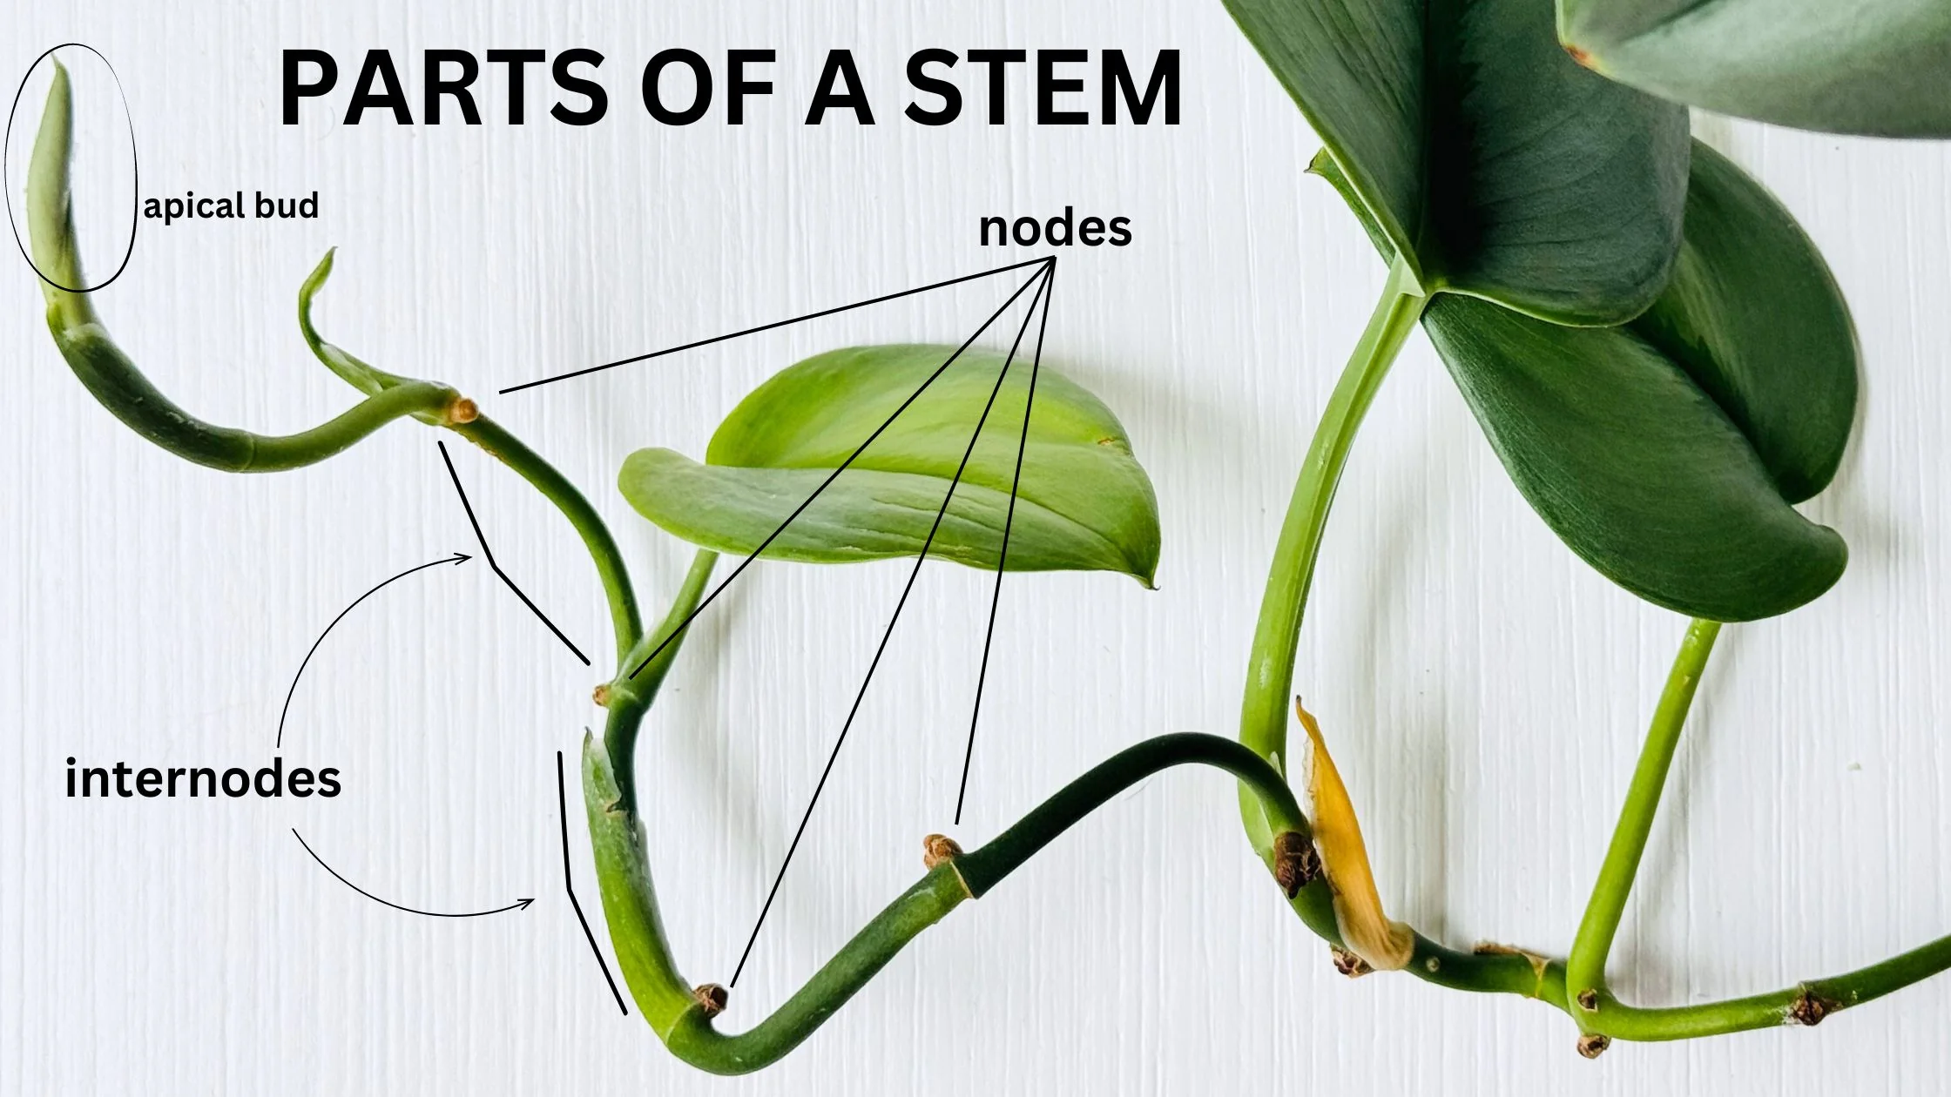

Slide 395
directed graphs

Slide 396
quick note: Math vs. CS

Slide 397
CS vs. Math
a directed graph is a data structure
it has nodes that refer to any number of other nodes
a directed graph G = (V, E) is also a mathematical object
it has vertices (nodes) V
it has directed edges E
note: E is a set of 2-tuples

Slide 398
these are really just two different ways of looking at the same thing

Slide 399
both are useful! (Math to figure out the algorithm, CS to code it up)

Slide 400
in CSCI 136, i will focus on the CS view (MATH 200, CSCI 256 will look at the Math side)

Slide 401
🙂👍

Slide 402
directed graph

Slide 403
the directed graph generalizes the linked list
a node in a directed graph has references to any number of other nodes
nodes are drawn as circles
references are drawn as arrows
let's not worry about
whether this is allowed
or whether this is allowed

Slide 404
(whether we allow for self-edges, multiple edges, etc. depends on context)

Slide 405
🙂👍

Slide 406
tree

Slide 407
kinship terminology (parent, child, etc.)

Slide 408
kinship terminology is useful for describing trees
a node has references to other nodes
it is their parent
they are its children

Slide 409
(directed) tree

Slide 410
a (directed) tree is a directed graph that...
has exactly one node with zero parents (the root)
has no nodes with more than one parent
has no cycles (loops) of any kind
is connected (just one tree, not multiple disconnected trees)
(otherwise, it would be a forest)
5
16
2
2
2
13
18
1
4
11
15
19

Slide 411
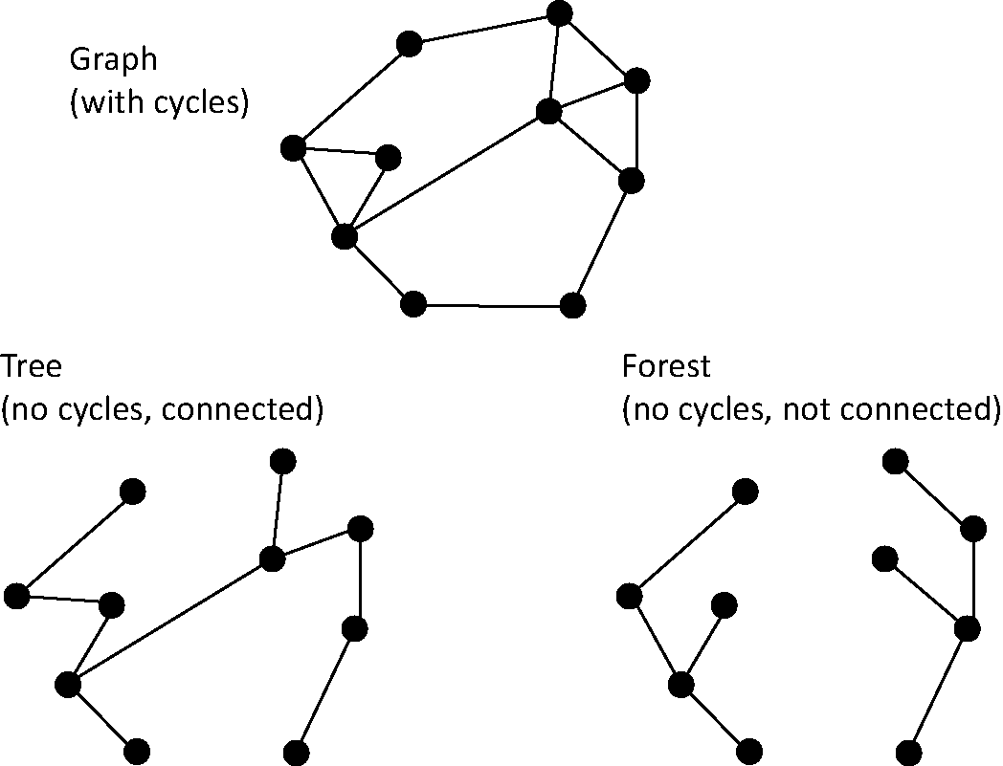
note: not joking

Slide 412
Monday Funday

Slide 413
time for everyone's favorite home game...

Slide 414
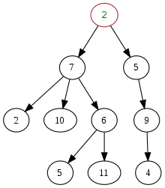
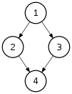
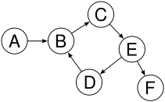
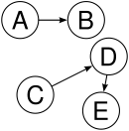

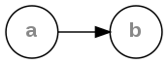
is it a tree?
yes
no
violates 2 & 3
tree rules
exactly one node with zero parents
no node with more than one parent
no cycles
is connected
no
violates 2 & 3
no
violates 1 & 4
no
violates 1 & 3
yes

Slide 415
is it a tree?
yes

Slide 416

can be seen as

Slide 417
uses of trees

Slide 418
simplifying expressions

Slide 419
(2 + 3)
* 4
*
+
4
2
3

Slide 420
5
* 4
*
5
4

Slide 421
20
20

Slide 422
!
(true && )
(false || true)
!
&&
true
||
false
true

Slide 423
!
(true && true)
!
&&
true
true

Slide 424
!true
!
true

Slide 425
false
false

Slide 426
and so much more!

Slide 427
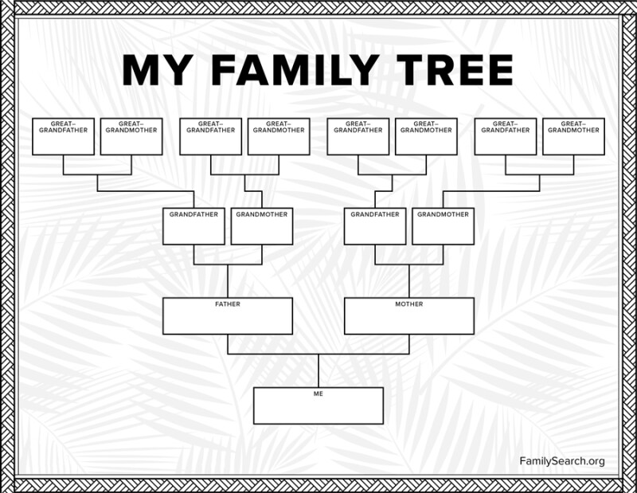

Slide 428
careful: these nodes are
the children of
the node with value jim
jim
jim's mom
jim's dad
jim's mom's mom
jim's mom's dad
jim's dad's mom
jim's dad's dad

Slide 429
note: family trees considered deeply confusing; let us never talk of them again 🙅

Slide 430
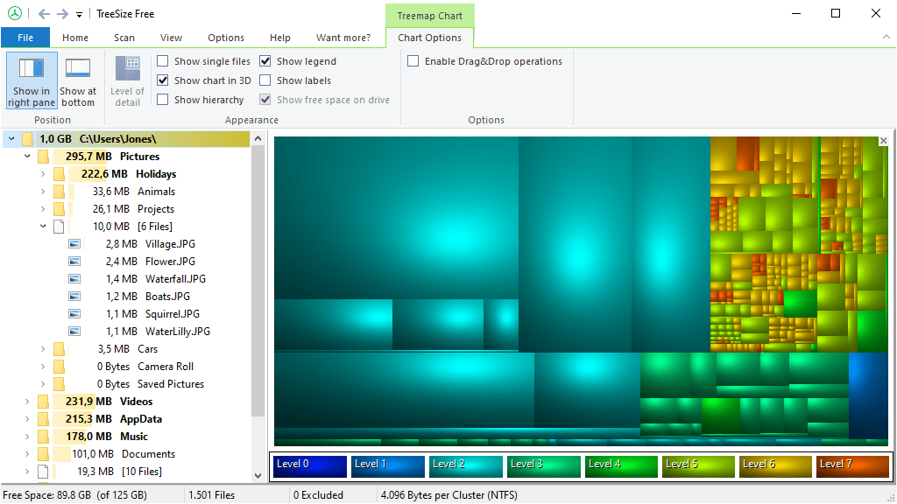
File System (TreeSize Free)
https://www.jam-software.com/treesize_free

Slide 431
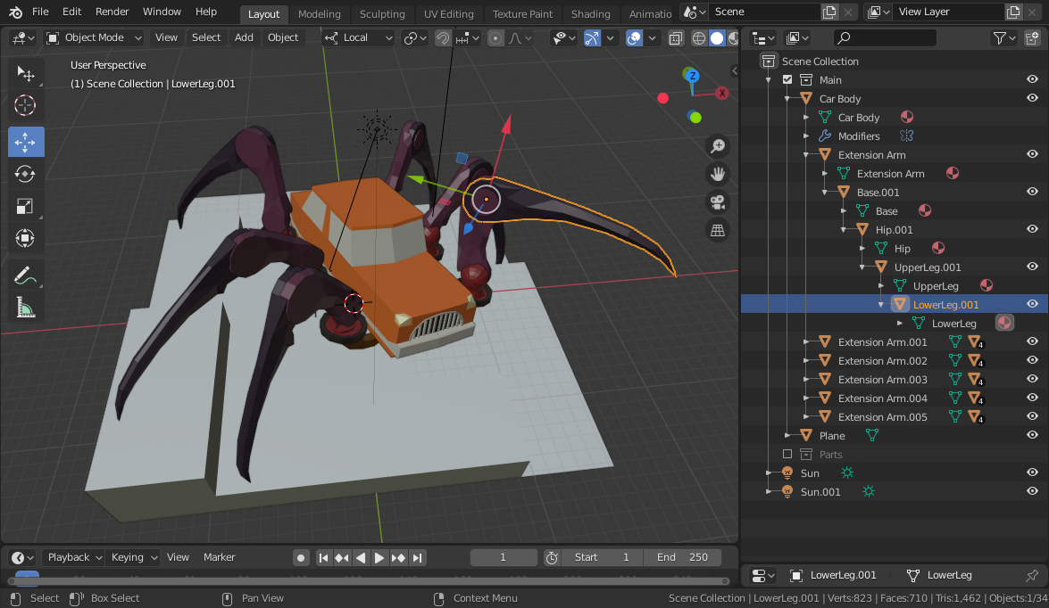
Transformation Hierarchy (Blender)
https://15466.courses.cs.cmu.edu/lesson/hierarchy

Slide 432
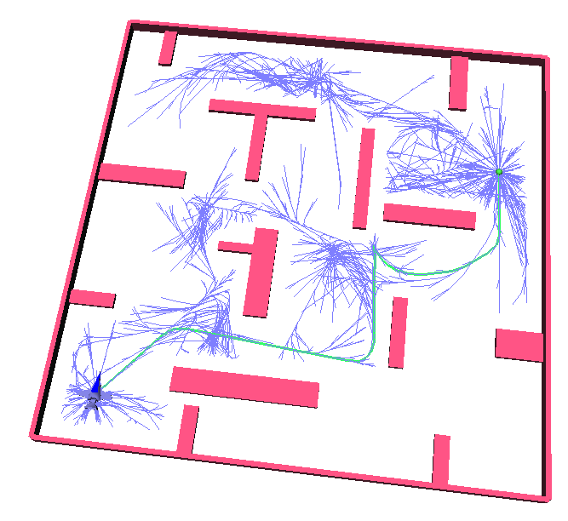
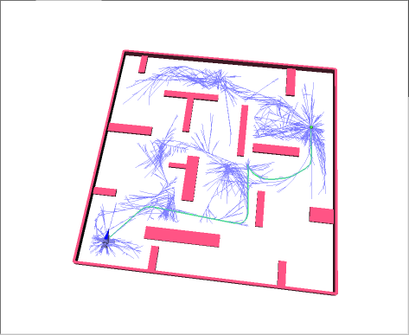
Rapidly Exploring Random Trees (RRTs)
Randomized Kinodynamic Planning by Steven M. LaValle and James J. Kuffner, Jr., International Journal of Robotics Research, 20(5):378--400, May 2001

Slide 433
Hierplane (Mark)

Slide 434
[homework preview]

Slide 435
different ways to implement trees

Slide 436
ArrayList<Node> children; Node leftChild; Node rightChild; Node[] children;

Slide 437
Week09b
✨Laptop Wednesday! ✨
for-each loop
tree terminology
terrific tree traversal tutorial
BONUS WARMUP
evaluate this expression tree
🦜🦜🦜
🦜🦜🦜
🦜🦜🦜
WARMUP
what does depth mean?
what does breadth mean?
what does first mean?

Slide 438
[address the election?]

Slide 439
[record lecture]

Slide 440
☠️ for-each loop

Slide 441
☠️ for-each loop

Slide 442
🐍 Python's for loop is a for-each loop
lst = [ True, 5.0, "Hello" ]
for element in lst: # for each item in the list...
print(element)

Slide 443
a for-each loop can be a convenient alternative to a for loop
for (int turretIndex = 0; turretIndex < turrets.length; ++turretIndex) {
Turret turret = turrets[turretIndex];
...
}
for (Turret turret : turrets) { // for each turret in turrets...
...
}

Slide 444
a for-each loop can be a convenient alternative to a for loop
for (int strokeIndex = 0; strokeIndex < currentFrame.size(); ++strokeIndex) {
ArrayList<Point> stroke = currentFrame.get(strokeIndex);
for (int pointIndex = 0; pointIndex < stroke.size(); ++pointIndex) {
Point point = stroke.get(pointIndex);
...
}
}
for (ArrayList<Point> stroke : currentFrame) {
for (Point point : stroke) {
...
}
}
forgive me 🥲
i swear all that indexing built character

Slide 445
for-each can be convenient but...

Slide 446
you never *need* a for-each loop (some languages don't even have one)

Slide 447
☠️ for-each loops can get you into trouble if you don't fully understand how references and Objects work in Java

Slide 448
☠️ for-each loop dangers
☠ a for-each loop provides a "convenient reference"
☠ LESS powerful than a regular for loop
for (int i = 0; i < things.length; ++i) {
Thing thing = things[i]; // thing is a "convenient reference"
...
}
for (Thing thing : things) { // thing is a "convenient reference"
...
}

Slide 449
☠️ for-each loop dangers
for (int i = 0; i < things.length; ++i) {
things[i] = new Thing(); // does write to array 🙂👍
}
for (int i = 0; i < things.length; ++i) {
Thing thing = things[i]; // thing is a "convenient reference"
thing = new Thing(); // does NOT write to array
}
for (Thing thing : things) { // thing is a "convenient reference"
thing = new Thing(); // does NOT write to array
}

Slide 450
☠️ for-each loop for iterating over a String
in Java, a for-each loop can iterate through String's with toCharArray()
☠ toCharArray() is O(n), but fine for CSCI 136
for (char c : string.toCharArray()) {
...
}

Slide 451
more tree terminology

Slide 452
more tree terminology

Slide 453
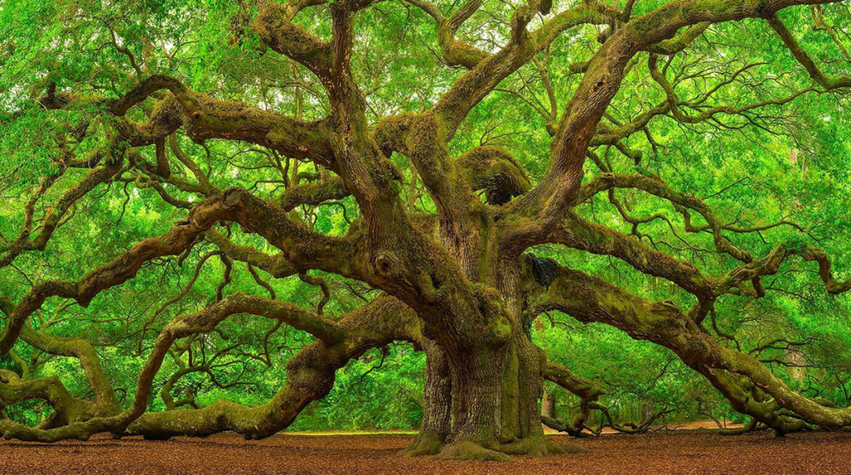

Slide 455
the root has no parents a leaf has no children
root
5
16
2
13
18
leaves

Slide 456
a path is a chain of distinct edges
16
path
13
18

Slide 457
a node's depth is the number of edges in the path from the root to that node
depth 0
5
16
depth 1
2
13
18
depth 2
depth 3

Slide 458
level means either depth or (depth + 1) depending on who you ask 🤷‍♀️

Slide 459
tree traversal

Slide 460
breadth-first vs. depth-first

Slide 461

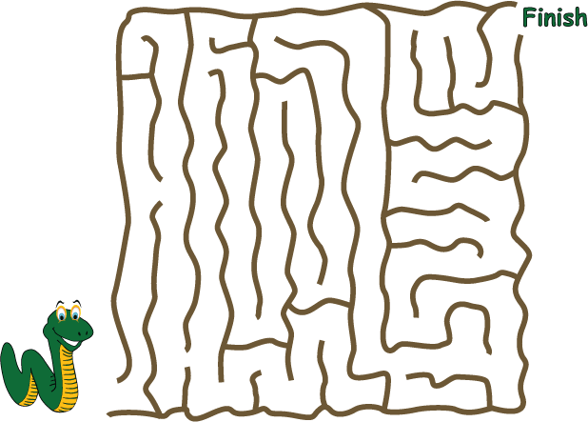
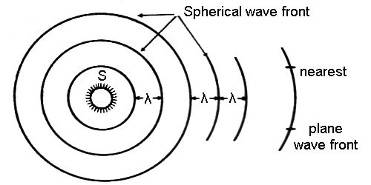
breadth-first vs. (pre-order) depth-first
"a persistent, optimistic, very thorough worm" –Mark Hopkins

Slide 462
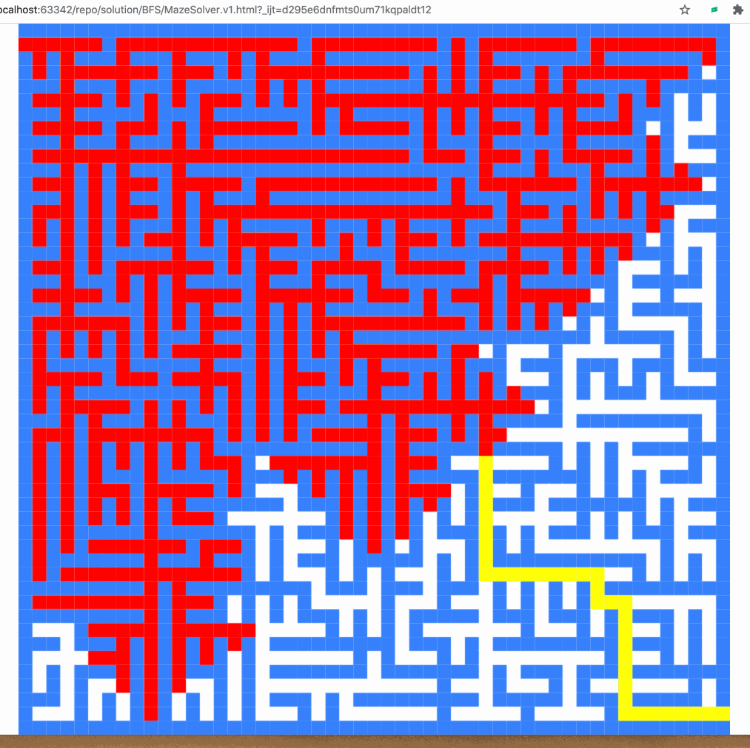
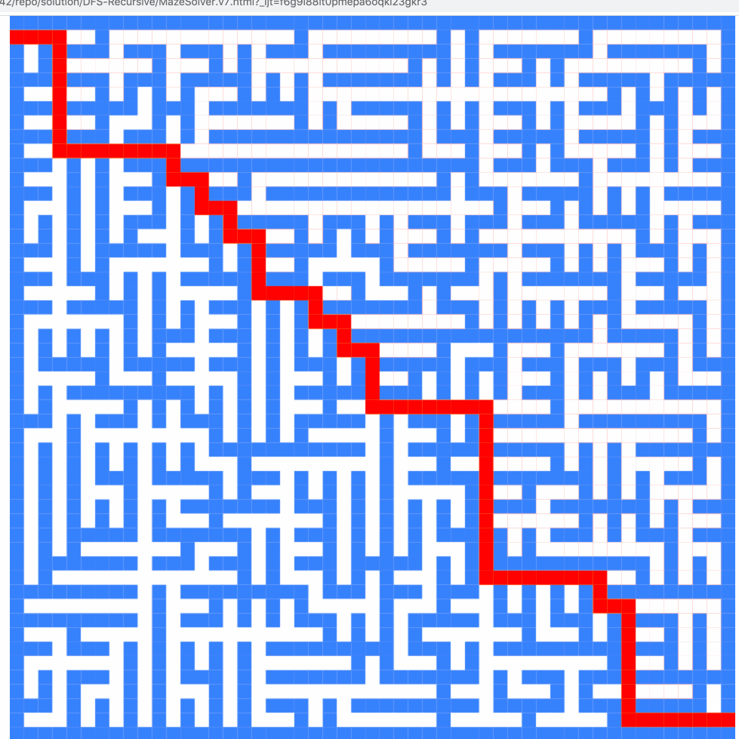
breadth-first vs. (pre-order) depth-first

Slide 463
breadth-first vs. (pre-order) depth-first
0
0
1
2
3
1
2
3
4
5
4
5
6
6
0
1
2
3
4
5
6
0
1
4
6
5
2
3

Slide 464
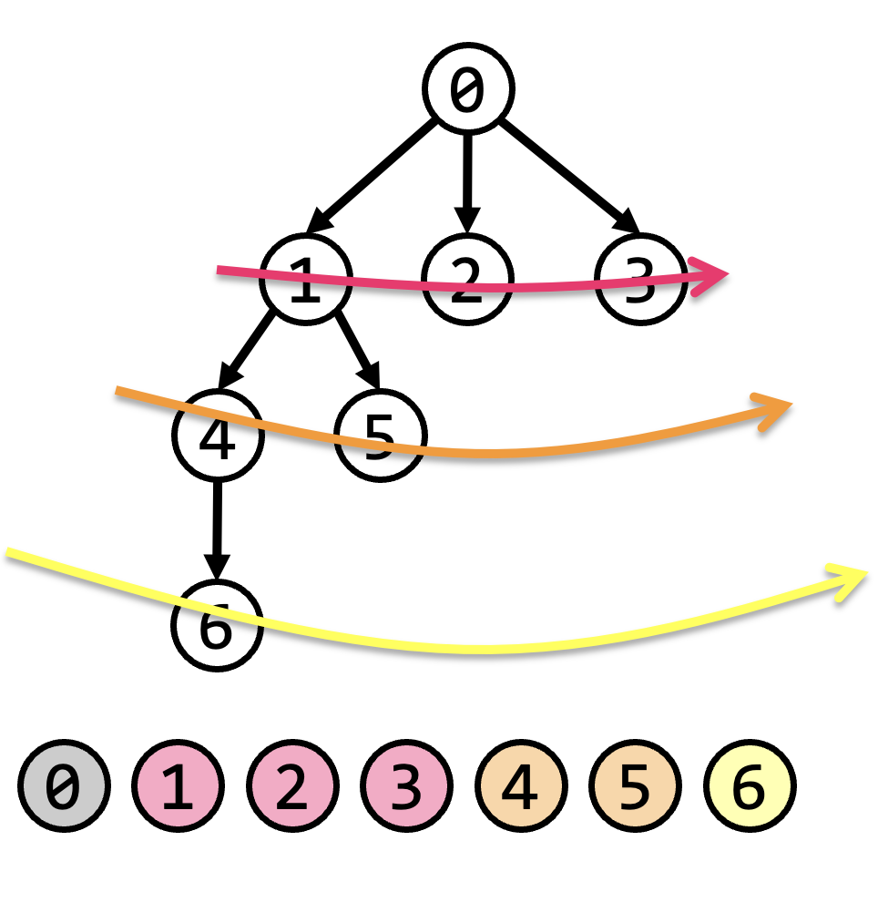
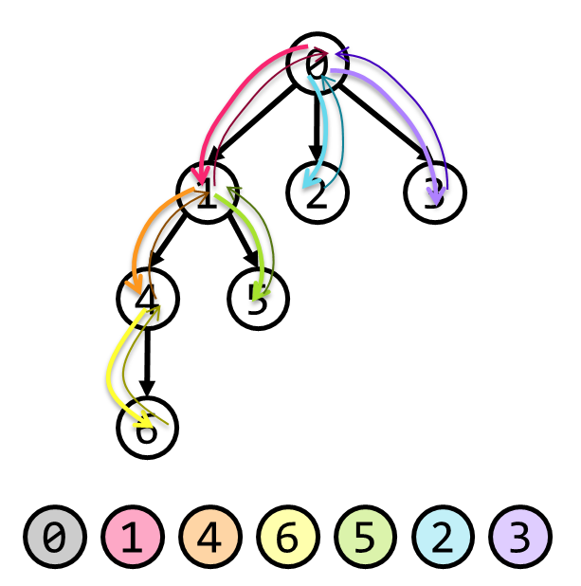
tree traversal (walking the tree)
tree traversal means iterating through all of the tree's nodes
breadth-first first explores as broadly (widely) as possible
one level (depth) at a time
uses a queue
depth-first first explores as deeply as possible
one root-to-leaf path at a time
uses a stack (or recursion, which uses the callstack)
☠ there are actually many different variants of depth-first traversal (i will explain them when we get to binary trees)

Slide 465
why might we want to traverse a tree? why did we want to traverse a linked list? do we ever *traverse* an array?

Slide 466
gathering all words in a trie (HW09)
searching for something (HW10?)
evaluating an expression tree
gathering all the nodes into a list (Tut09)

Slide 467
Terrific Tree Traversal Tutorial

Slide 468
explanation

Slide 469
Week09c
Friday.
trees vs. graphs
WARMUP
have you ever played the game Worms World Party?
how would you implement it?

Slide 470
[record lecture]

Slide 471
Terrific Tree Traversal Tutorial treview

Slide 472
traverseBreadthFirst
change color to indicate
hasBeenVisited = true
0 added to queue
0 removed from queue
1 added to queue
2 added to queue
3 added to queue
1 removed from queue
4 added to queue
5 added to queue
2 removed from queue
3 removed from queue
6 added to queue
4 removed from queue
5 removed from queue
6 removed from queue
7 added to queue
7 removed from queue
0
1
2
3
4
5
6
queue.add(root)
while queue not empty:
curr = queue.remove()
... # process curr
for child in curr.children:
queue.add(child)
7
0
1
2
3
4
5
6
7

Slide 473
traversePreOrderDepthFirst
change color to indicate
hasBeenVisited = true
start recurse(0)
start recurse(1)
start recurse(4)
finish recurse(4)
start recurse(5)
finish recurse(5)
finish recurse(1)
start recurse(2)
finish recurse(2)
start recurse(3)
start recurse(6)
start recurse(7)
finish recurse(7)
finish recurse(6)
finish recurse(3)
finish recurse(0)
0
1
2
3
4
5
6
def recurse(curr):
... # process curr
for child in curr.children:
recurse(child)
7
recurse(root)
0
1
4
5
2
3
6
7

Slide 474
example: two a-maze-ing mazes

Slide 475
maze A

Slide 476
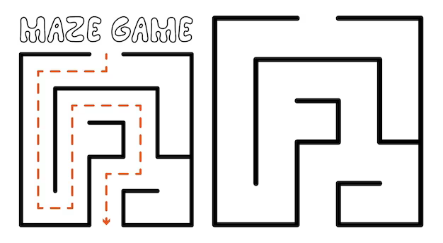

start
finish

Slide 508
maze B

Slide 509
start
finish

Slide 510
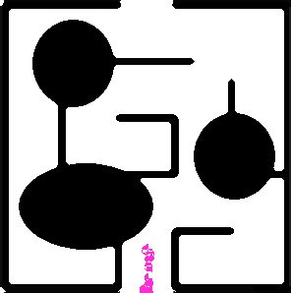

Slide 512
[worms world party]

Slide 513
trees vs. graphs

Slide 514
the problem with naively traversing a graph

Slide 515
directed cycles (loops) in the graph will create infinite loops in your code

Slide 516
[example (live coding)]
0
1
2
3

Slide 517
how to traverse a graph

Slide 518
to traverse a graph, you need to keep track of which nodes you have visited
Option A: Store a boolean called hasBeenVisited on each Node.
Option B: Use another data structure to keep track of visited nodes.
for example, HashMap<Node, Boolean> hasNodeBeenVisited;
or even better (smaller), HashSet<Node> visitedNodes;

Slide 519
example: traversing a graph with a directed cycle
1
2
3

Slide 520
example: flood fill 🪣

Slide 521
quadtree rabbit hole 🐰

Slide 522
problem: naive collision detection is slow O(n^2) to check all pairs

Slide 523
idea: use a grid O(n) to assign all circles to grid cells

Slide 524
problem: so many grid cells; most empty!

Slide 525
idea: "only have grid where you need it"

Slide 526
problem: how do we store this?

Slide 527
idea: a tree

Slide 528
idea: a tree

Slide 529
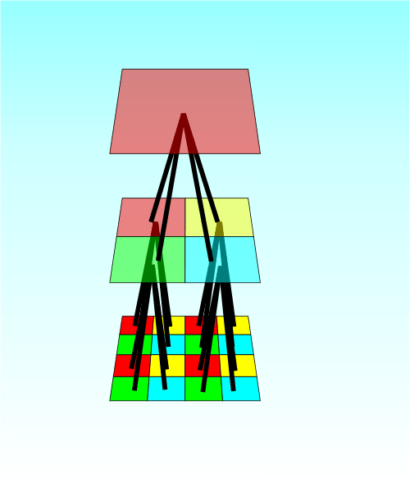

Slide 530
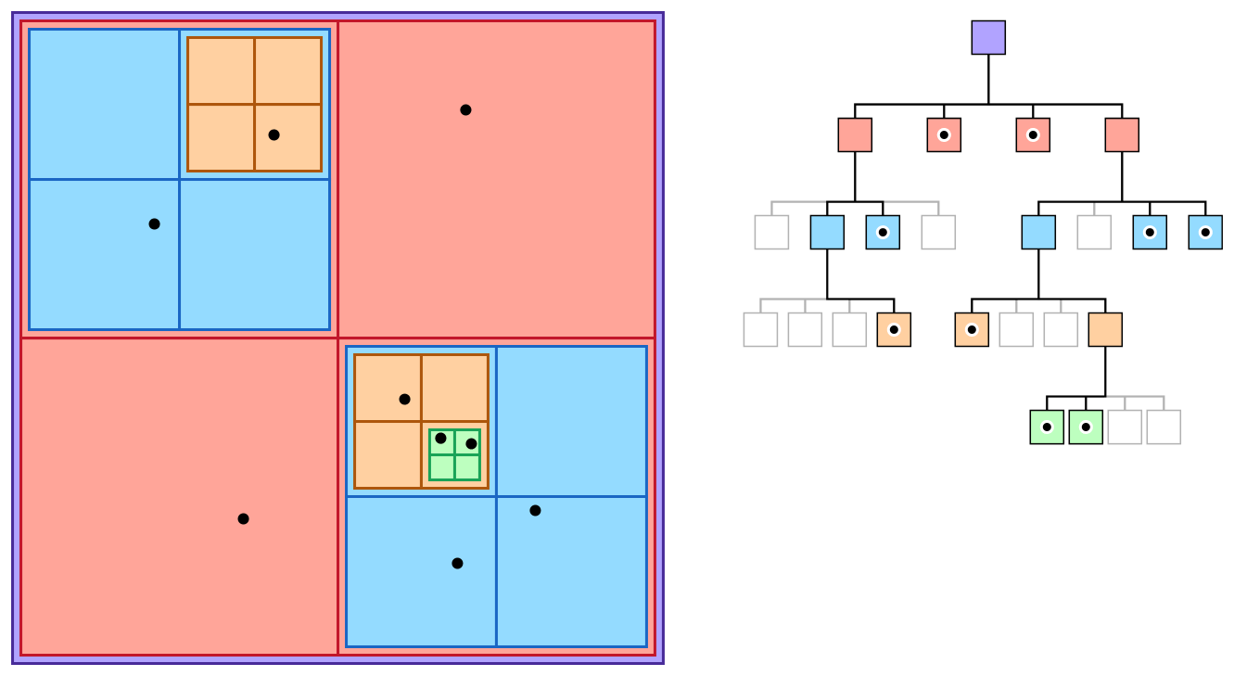

Slide 531
quadtree reading

